Slide 1
Econ 642: Week 11
Open Economy
Garin et al. Chapter 23, 30

Slide 2
Announcements
Discussion 11 is available
Problem Set 4 is due on Sunday Feb 11
Study Guide will be available

Slide 3
Overview
Exports, Imports, and Exchange Rates
Adding Net Exports to Flexible Price Model
Shocks in Price Flexible model
Adding Net Exports to Sticky Price Model
Shocks in Sticky Price Model
Fixed Exchange Rate Policies

Slide 4
Overview
We’ll get rid of the closed economy assumption
We’ll add Imports and Exports to our GDP accounting equation
Net exports will be the difference between exports and imports
We’ll also specific domestic vs foreign
Domestic will be our home country of interest
Foreign will be the rest of the world
Key takeaways
Net exports will depend on the real interest rate differential between domestic real interest rate and foreign real interest rate and the real exchange rate

Slide 5
Exports, Imports, and Exchange Rates

Slide 6
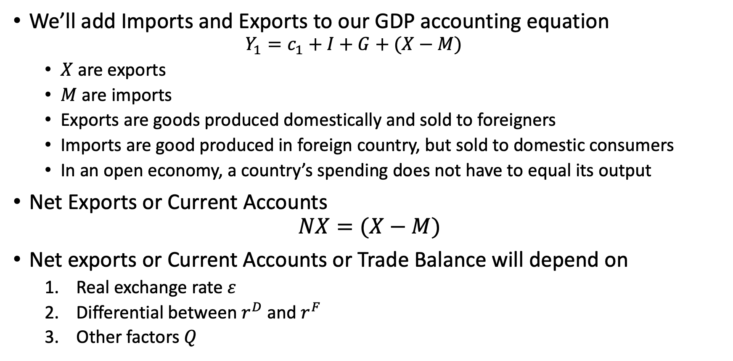
Exports, Imports, and Exchange Rates
We’ll add Imports and Exports to our GDP accounting equation
$$Y_{1}=c_{1}+I+G+(X−M)$$
$X$ are exports
$M$ are imports
Exports are goods produced domestically and sold to foreigners
Imports are good produced in foreign country, but sold to domestic consumers
In an open economy, a country’s spending does not have to equal its output
Net Exports or Current Accounts
$$NX=(X−M)$$
Net exports or Current Accounts or Trade Balance will depend on
Real exchange rate $ε$
Differential between $r^{D}$ and $r^{F}$
Other factors $Q$

Slide 7
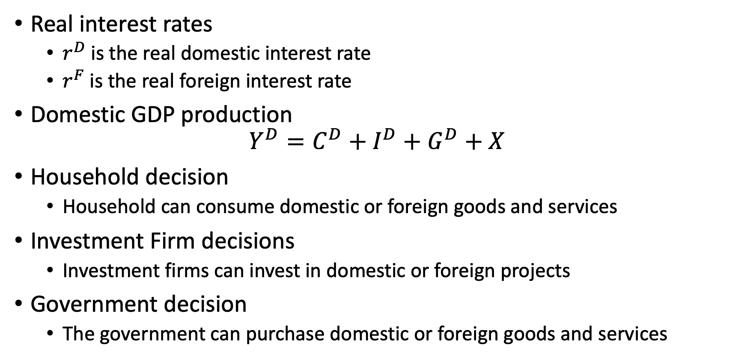
Exports, Imports, and Exchange Rates
Real interest rates
$r^{D}$ is the real domestic interest rate
$r^{F}$ is the real foreign interest rate
Domestic GDP production
$$Y^{D}=C^{D}+I^{D}+G^{D}+X$$
Household decision
Household can consume domestic or foreign goods and services
Investment Firm decisions
Investment firms can invest in domestic or foreign projects
Government decision
The government can purchase domestic or foreign goods and services

Slide 8
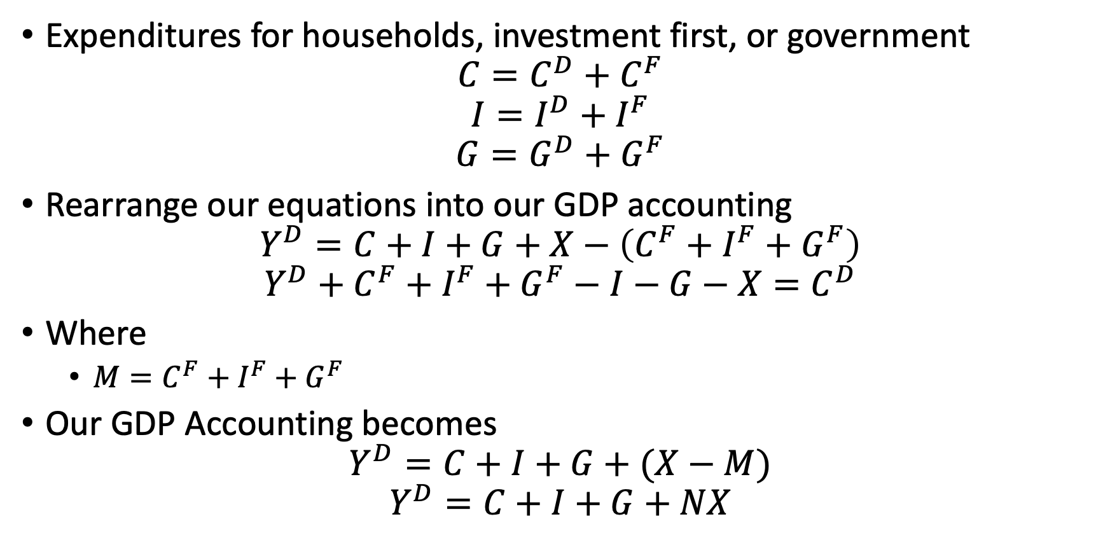
Exports, Imports, and Exchange Rates
Expenditures for households, investment first, or government
$$C=C^{D}+C^{F}$$
$$I=I^{D}+I^{F}$$
$$G=G^{D}+G^{F}$$
Rearrange our equations into our GDP accounting
$$Y^{D}=C+I+G+X−\left(C^{F}+I^{F}+G^{F}\right)$$
$$Y^{D}+C^{F}+I^{F}+G^{F}−I−G−X=C^{D}$$
Where
$M=C^{F}+I^{F}+G^{F}$
Our GDP Accounting becomes
$$Y^{D}=C+I+G+(X−M)$$
$$Y^{D}=C+I+G+NX$$

Slide 9
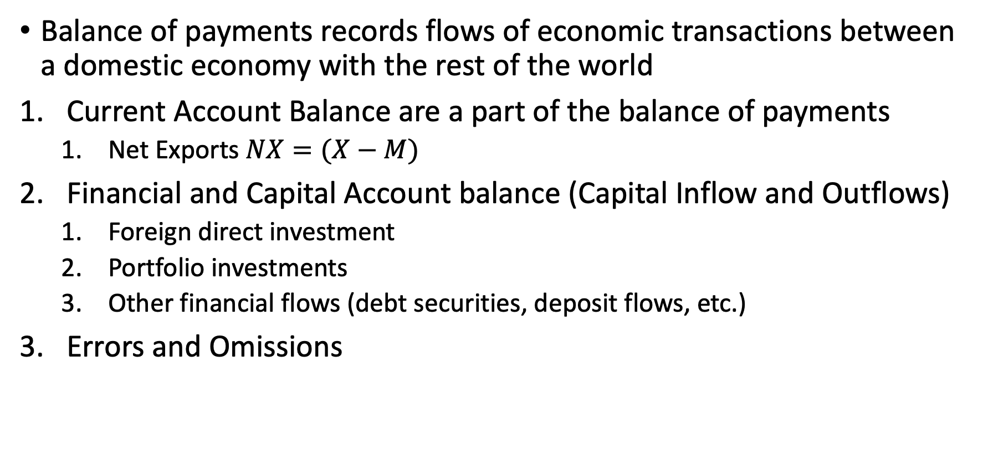
Balance of Payments
Balance of payments records flows of economic transactions between a domestic economy with the rest of the world
Current Account Balance are a part of the balance of payments
Net Exports $NX=(X−M)$
Financial and Capital Account balance (Capital Inflow and Outflows)
Foreign direct investment
Portfolio investments
Other financial flows (debt securities, deposit flows, etc.)
Errors and Omissions
https://www.imf.org/external/np/sta/bop/BOPman.pdf

Slide 10
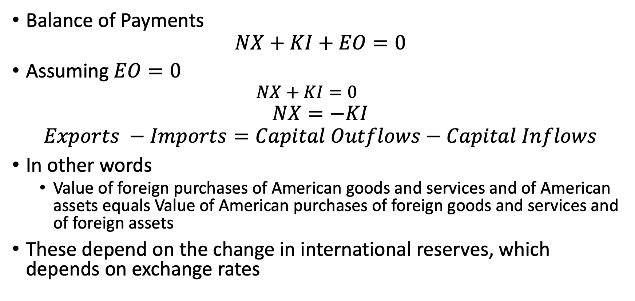
Balance of Payments
Balance of Payments
$$NX+KI+EO=0$$
Assuming $EO=0$
$$NX+KI=0$$
$$NX=−KI$$
$$Exports −Imports=Capital Outflows−Capital Inflows$$
In other words
Value of foreign purchases of American goods and services and of American assets equals Value of American purchases of foreign goods and services and of foreign assets
These depend on the change in international reserves, which depends on exchange rates
https://www.imf.org/external/np/sta/bop/BOPman.pdf

Slide 11
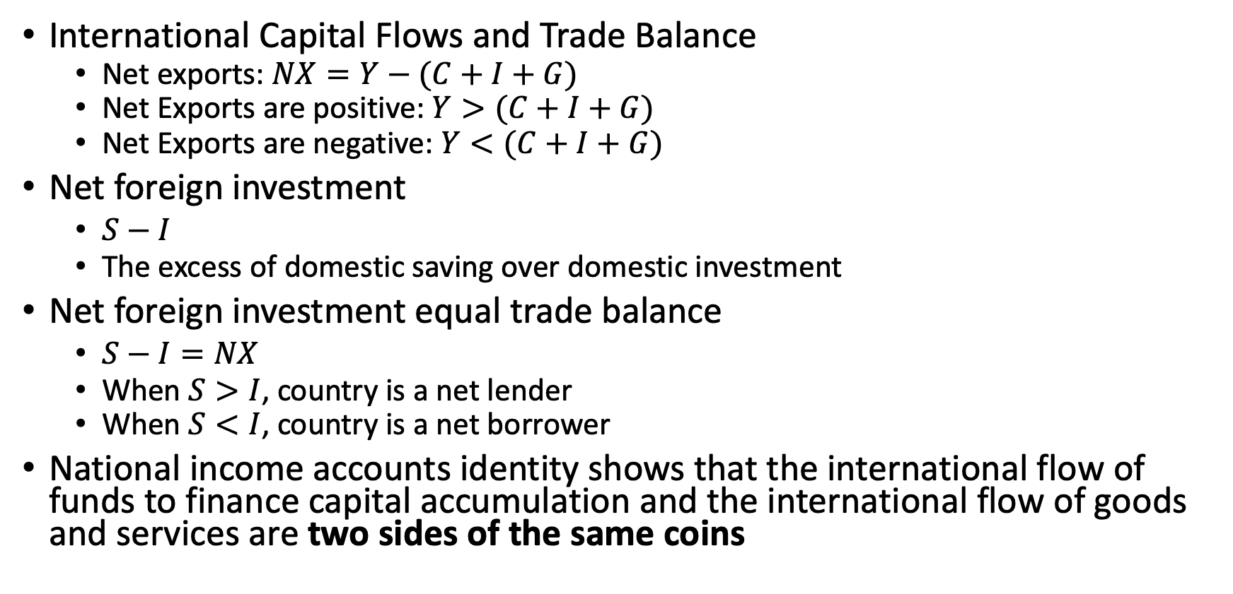
Exports, Imports, and Exchange Rates
International Capital Flows and Trade Balance
Net exports: $NX=Y−(C+I+G)$
Net Exports are positive: $Y>(C+I+G)$
Net Exports are negative: $Y<(C+I+G)$
Net foreign investment
$S−I$
The excess of domestic saving over domestic investment
Net foreign investment equal trade balance
$S−I=NX$
When $S>I$, country is a net lender
When $S<I$, country is a net borrower
National income accounts identity shows that the international flow of funds to finance capital accumulation and the international flow of goods and services are two sides of the same coins

Slide 12
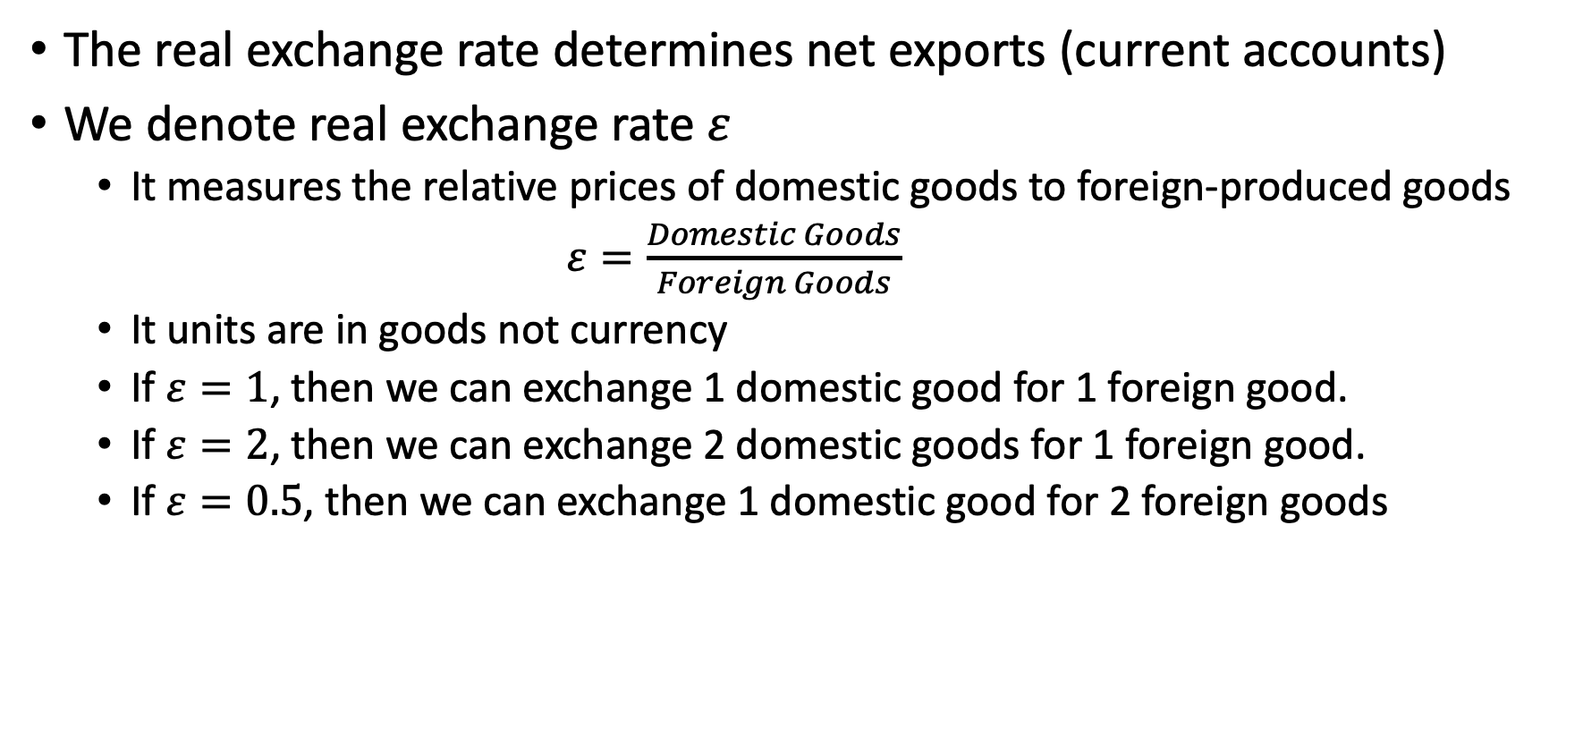
Exports, Imports, and Exchange Rates
The real exchange rate determines net exports (current accounts)
We denote real exchange rate $ε$
It measures the relative prices of domestic goods to foreign-produced goods
$ε=\frac{Domestic Goods}{Foreign Goods}$
It units are in goods not currency
If $ε=1$, then we can exchange 1 domestic good for 1 foreign good.
If $ε=2$, then we can exchange 2 domestic goods for 1 foreign good.
If $ε=0.5$, then we can exchange 1 domestic good for 2 foreign goods

Slide 13
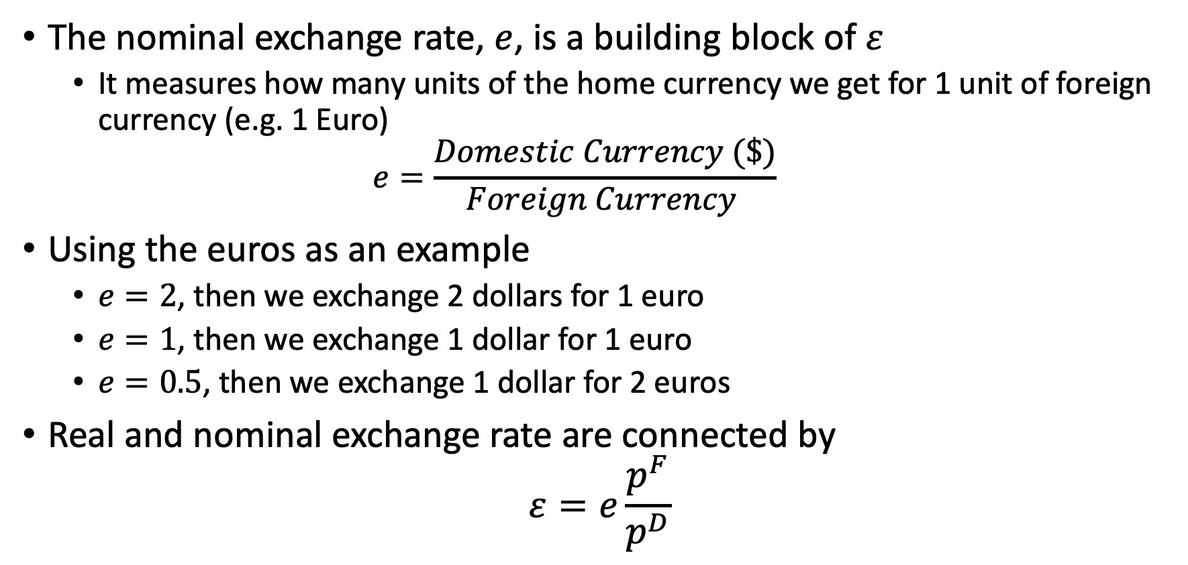
Exports, Imports, and Exchange Rates
The nominal exchange rate, $e$, is a building block of $ε$
It measures how many units of the home currency we get for 1 unit of foreign currency (e.g. 1 Euro)
$$e=\frac{Domestic Currency (\$)}{Foreign Currency }$$
Using the euros as an example
$e=2$, then we exchange 2 dollars for 1 euro
$e=1$, then we exchange 1 dollar for 1 euro
$e=0.5$, then we exchange 1 dollar for 2 euros
Real and nominal exchange rate are connected by
$$ε=e\frac{p^{F}}{p^{D}}$$

Slide 14
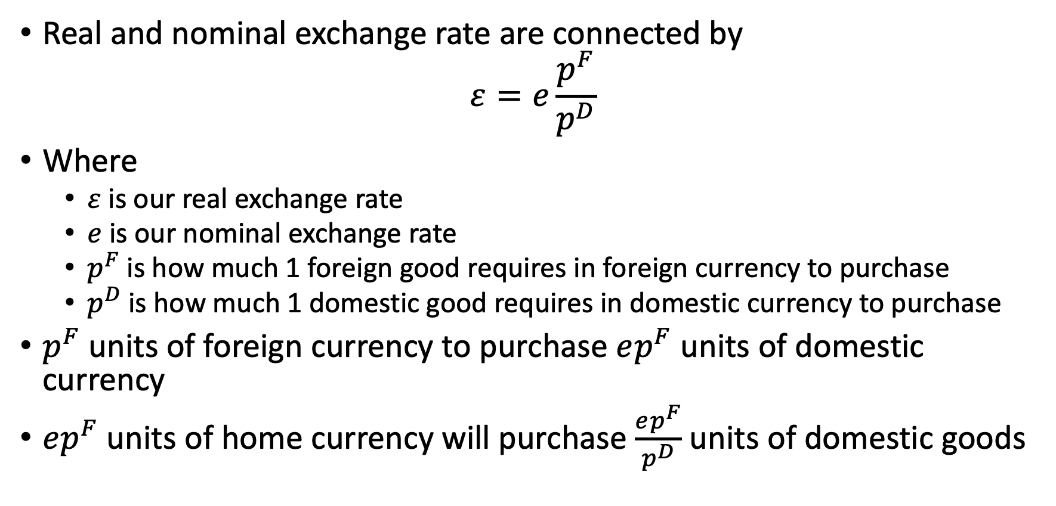
Exports, Imports, and Exchange Rates
Real and nominal exchange rate are connected by
$$ε=e\frac{p^{F}}{p^{D}}$$
Where
$ε$ is our real exchange rate
$e$ is our nominal exchange rate
$p^{F}$ is how much 1 foreign good requires in foreign currency to purchase
$p^{D}$ is how much 1 domestic good requires in domestic currency to purchase
$p^{F}$ units of foreign currency to purchase $ep^{F}$ units of domestic currency
$ep^{F}$ units of home currency will purchase $\frac{ep^{F}}{p^{D}}$ units of domestic goods

Slide 15
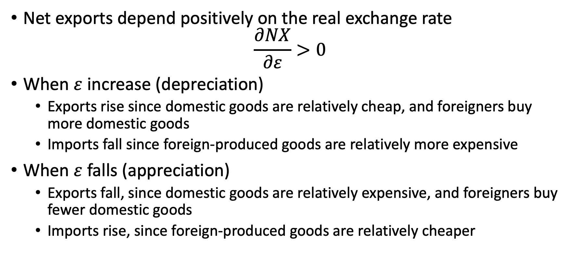
Exports, Imports, and Exchange Rates
Net exports depend positively on the real exchange rate
$$\frac{∂NX}{∂ε}>0$$
When $ε$ increase (depreciation)
Exports rise since domestic goods are relatively cheap, and foreigners buy more domestic goods
Imports fall since foreign-produced goods are relatively more expensive
When $ε$ falls (appreciation)
Exports fall, since domestic goods are relatively expensive, and foreigners buy fewer domestic goods
Imports rise, since foreign-produced goods are relatively cheaper

Slide 16
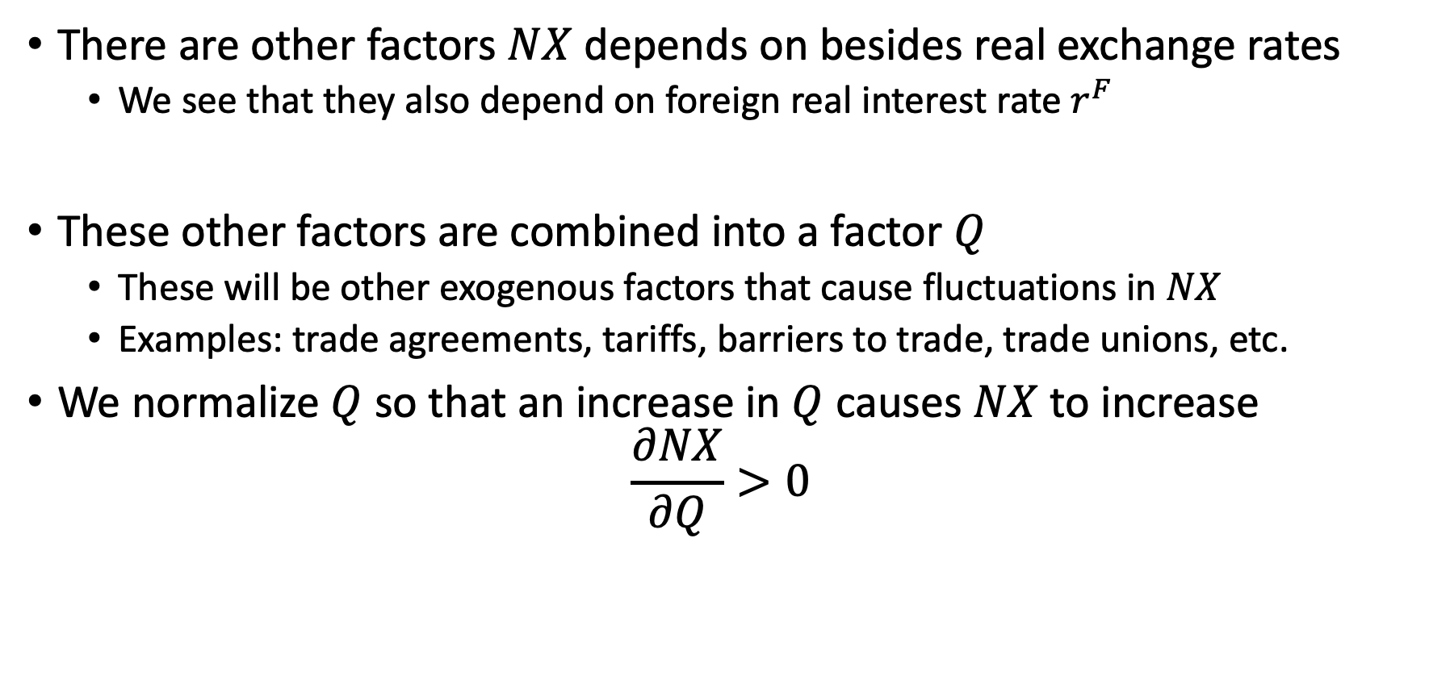
Exports, Imports, and Exchange Rates
There are other factors $NX$ depends on besides real exchange rates
We see that they also depend on foreign real interest rate $r^{F}$
These other factors are combined into a factor $Q$
These will be other exogenous factors that cause fluctuations in $NX$
Examples: trade agreements, tariffs, barriers to trade, trade unions, etc.
We normalize $Q$ so that an increase in $Q$ causes $NX$ to increase
$$\frac{∂NX}{∂Q}>0$$

Slide 17
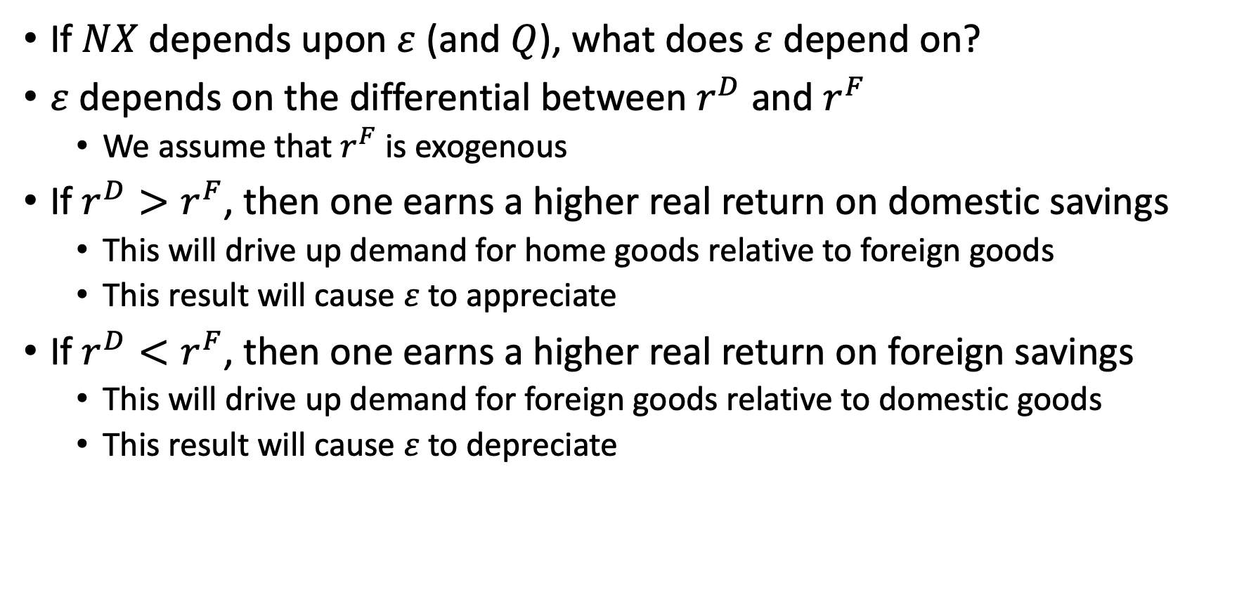
Exports, Imports, and Exchange Rates
If $NX$ depends upon $ε$ (and $Q$), what does $ε$ depend on?
$ε$ depends on the differential between $r^{D}$ and $r^{F}$
We assume that $r^{F}$ is exogenous
If $r^{D}>r^{F}$, then one earns a higher real return on domestic savings
This will drive up demand for home goods relative to foreign goods
This result will cause $ε$ to appreciate
If $r^{D}<r^{F}$, then one earns a higher real return on foreign savings
This will drive up demand for foreign goods relative to domestic goods
This result will cause $ε$ to depreciate

Slide 18
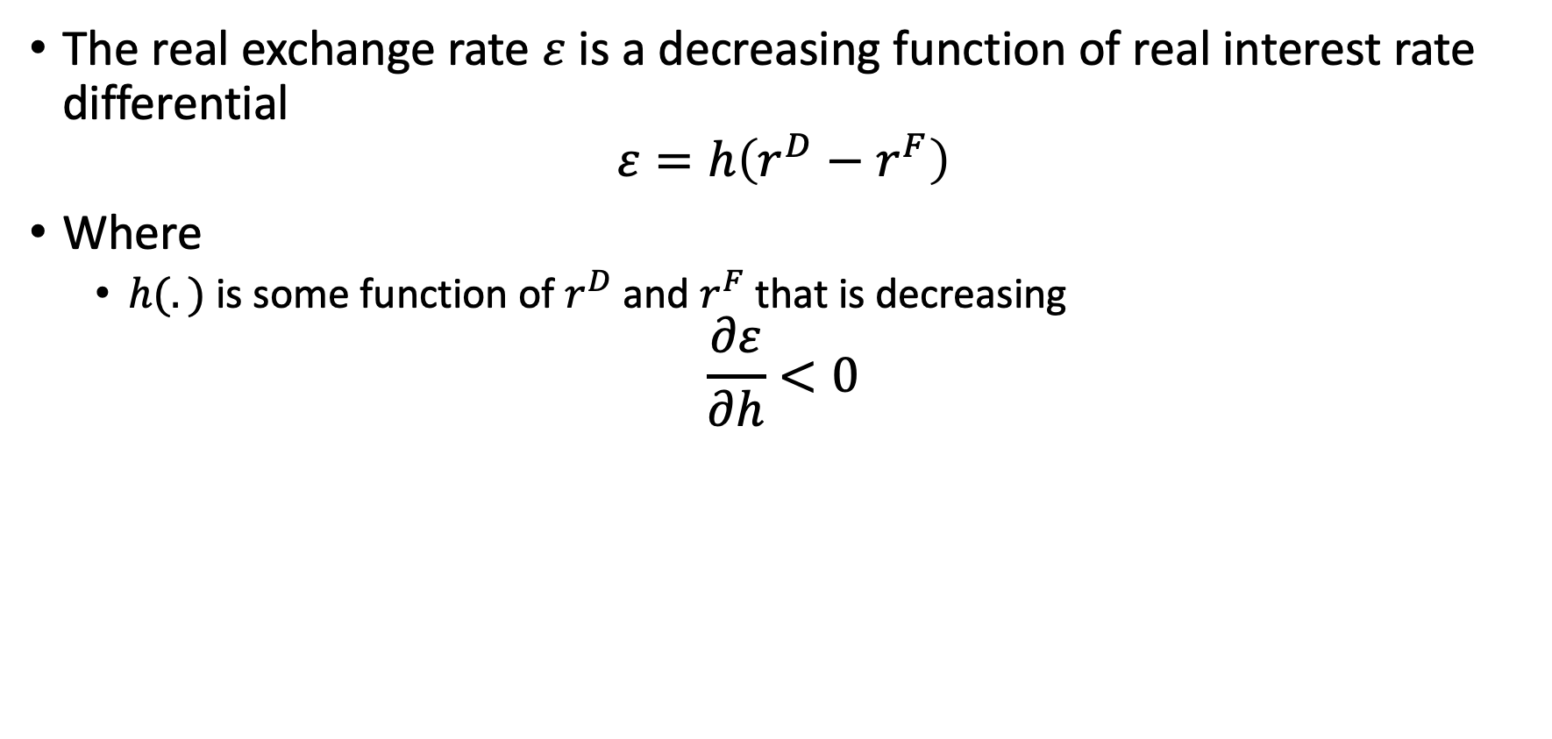
Exports, Imports, and Exchange Rates
The real exchange rate $ε$ is a decreasing function of real interest rate differential
$$ε=h\left(r^{D}−r^{F}\right)$$
Where
$h(.)$ is some function of $r^{D}$ and $r^{F}$ that is decreasing
$$\frac{∂ε}{∂h}<0$$

Slide 19
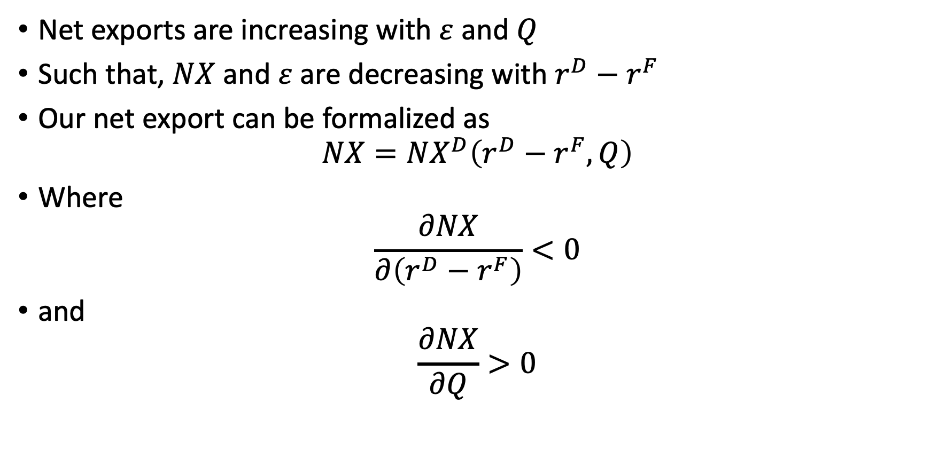
Exports, Imports, and Exchange Rates
Net exports are increasing with $ε$ and $Q$
Such that, $NX$ and $ε$ are decreasing with $r^{D}−r^{F}$
Our net export can be formalized as
$$NX=NX^{D}\left(r^{D}−r^{F},Q\right)$$
Where
$$\frac{∂NX}{∂\left(r^{D}−r^{F}\right)}<0$$
and
$$\frac{∂NX}{∂Q}>0$$

Slide 20
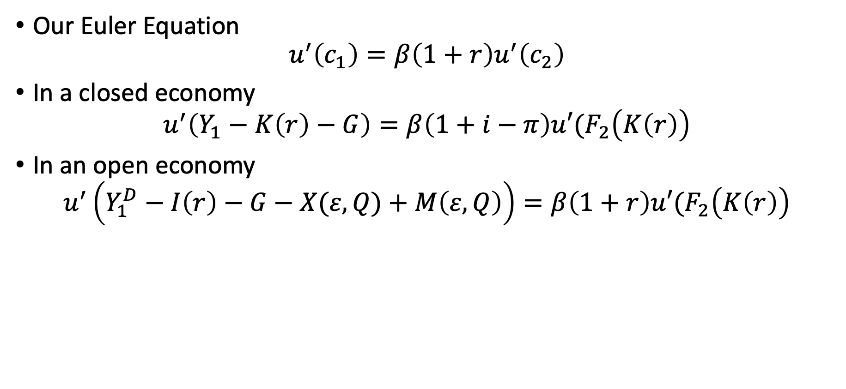
Exports, Imports, and Exchange Rates
Our Euler Equation
$$u^{′}\left(c_{1}\right)=β\left(1+r\right)u^{′}\left(c_{2}\right)$$
In a closed economy
$$u^{′}\left(Y_{1}−K\left(r\right)−G\right)=β\left(1+i−π\right)u′(F_{2}\left(K\left(r\right)\right)$$
In an open economy
$$u^{′}\left(Y_{1}^{D}−I\left(r\right)−G−X(ε,Q)+M\left(ε,Q\right)\right)=β\left(1+r\right)u′(F_{2}\left(K\left(r\right)\right)$$

Slide 21
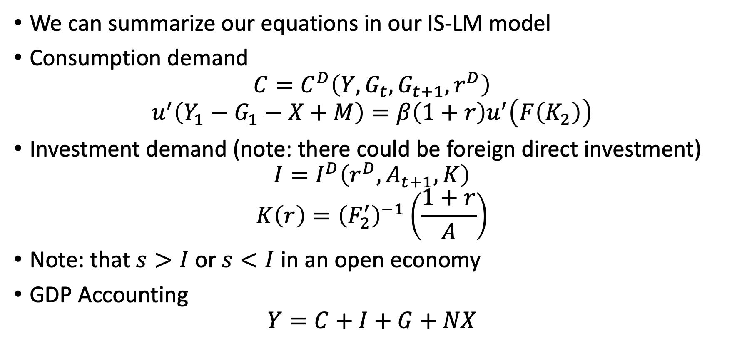
Exports, Imports, and Exchange Rates
We can summarize our equations in our IS-LM model
Consumption demand
$$C=C^{D}\left(Y,G_{t},G_{t+1},r^{D}\right)$$
$$u^{′}\left(Y_{1}−G_{1}−X+M\right)=β\left(1+r\right)u^{′}\left(F\left(K_{2}\right)\right)$$
Investment demand (note: there could be foreign direct investment)
$$I=I^{D}\left(r^{D},A_{t+1},K\right)$$
$$K\left(r\right)={\left(F_{2}^{′}\right)}^{−1}\left(\frac{1+r}{A}\right)$$
Note: that $s>I$ or $s<I$ in an open economy
GDP Accounting
$$Y=C+I+G+NX$$

Slide 22
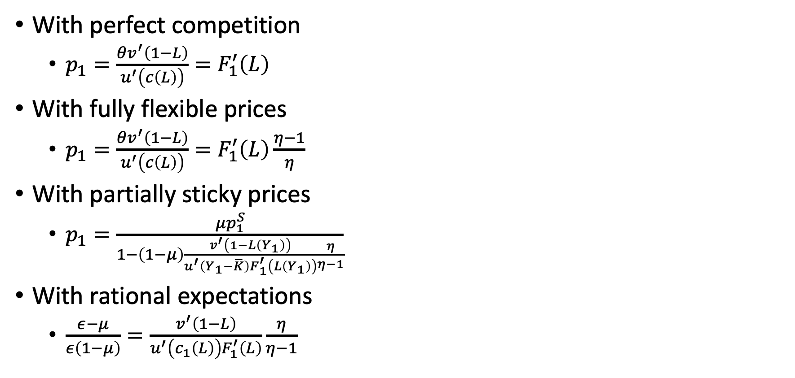
Exports, Imports, and Exchange Rates
With perfect competition
$p_{1}=\frac{θv^{′}\left(1−L\right)}{u^{′}\left(c\left(L\right)\right)}=F_{1}^{′}\left(L\right)$
With fully flexible prices
$p_{1}=\frac{θv^{′}\left(1−L\right)}{u^{′}\left(c\left(L\right)\right)}=F_{1}^{′}\left(L\right)\frac{η−1}{η}$
With partially sticky prices
$p_{1}=\frac{μp_{1}^{S}}{1−\left(1−μ\right)\frac{v^{′}\left(1−L\left(Y_{1}\right)\right)}{u^{′}\left(Y_{1}−\overline{K}\right)F_{1}^{′}\left(L\left(Y_{1}\right)\right)}\frac{η}{η−1}}$
With rational expectations
$\frac{ε−μ}{ε\left(1−μ\right)}=\frac{v^{′}\left(1−L\right)}{u^{′}\left(c_{1}\left(L\right)\right)F_{1}^{′}\left(L\right)}\frac{η}{η−1}$

Slide 23
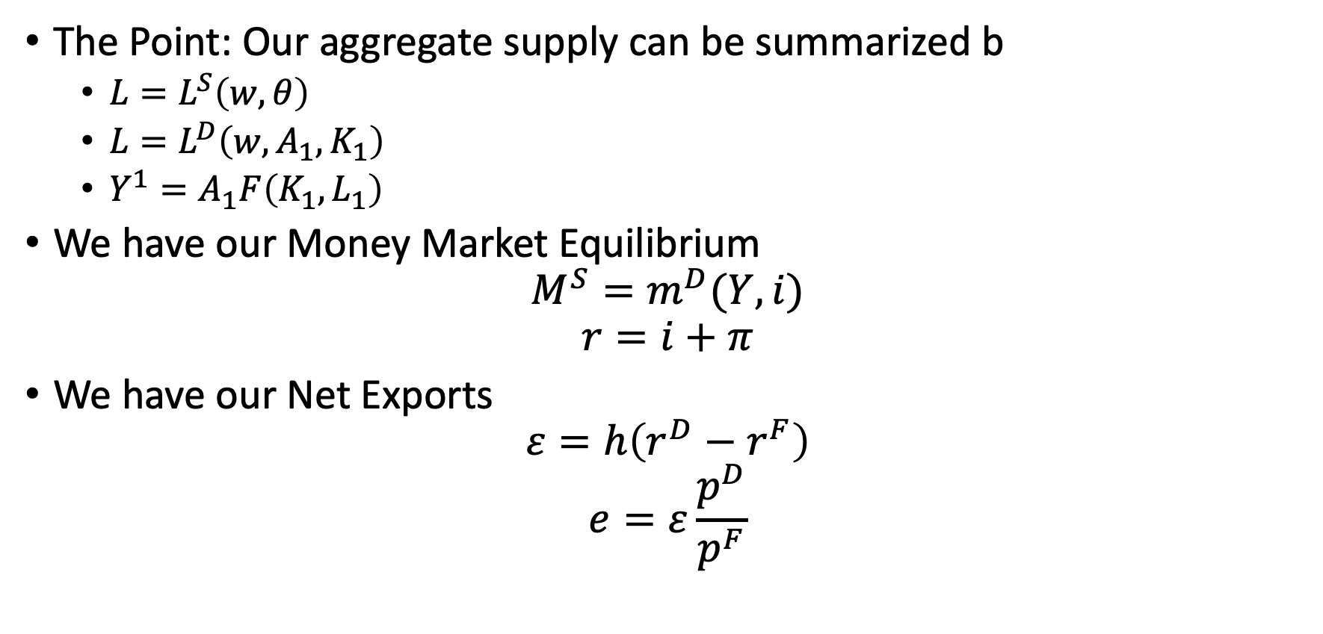
Exports, Imports, and Exchange Rates
The Point: Our aggregate supply can be summarized b
$L=L^{S}\left(w,θ\right)$
$L=L^{D}\left(w,A_{1},K_{1}\right)$
$Y^{1}=A_{1}F\left(K_{1},L_{1}\right)$
We have our Money Market Equilibrium
$$M^{S}=m^{D}(Y,i)$$
$$r=i+π$$
We have our Net Exports
$$ε=h\left(r^{D}−r^{F}\right)$$
$$e=ε\frac{p^{D}}{p^{F}}$$

Slide 24
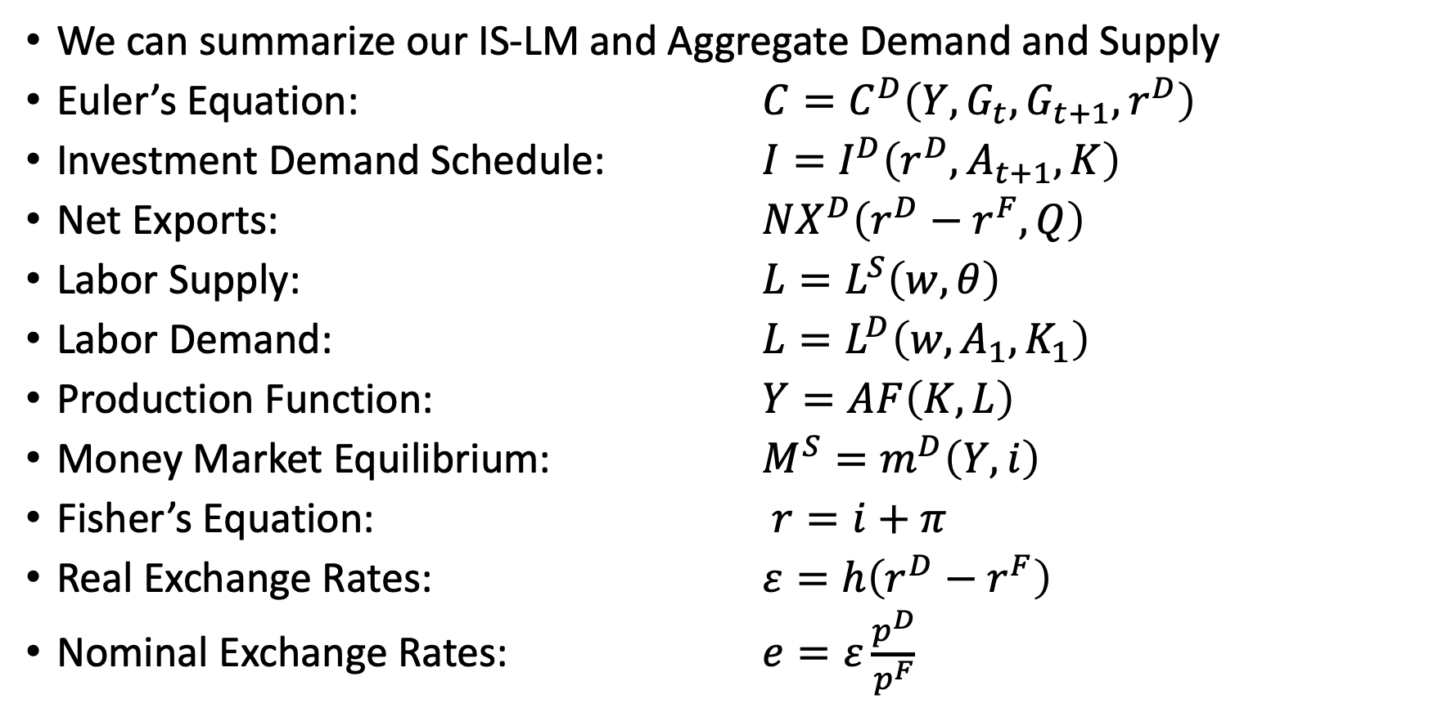
Exports, Imports, and Exchange Rates
We can summarize our IS-LM and Aggregate Demand and Supply
Euler’s Equation: $C=C^{D}\left(Y,G_{t},G_{t+1},r^{D}\right)$
Investment Demand Schedule: $I=I^{D}\left(r^{D},A_{t+1},K\right)$
Net Exports: $NX^{D}\left(r^{D}−r^{F},Q\right)$
Labor Supply: $L=L^{S}\left(w,θ\right)$
Labor Demand: $L=L^{D}\left(w,A_{1},K_{1}\right)$
Production Function: $Y=AF\left(K,L\right)$
Money Market Equilibrium: $M^{S}=m^{D}\left(Y,i\right)$
Fisher’s Equation: $r=i+π$
Real Exchange Rates: $ε=h\left(r^{D}−r^{F}\right)$
Nominal Exchange Rates: $e=ε\frac{p^{D}}{p^{F}}$

Slide 25
Adding Net Exports to Price Flexible Model

Slide 26
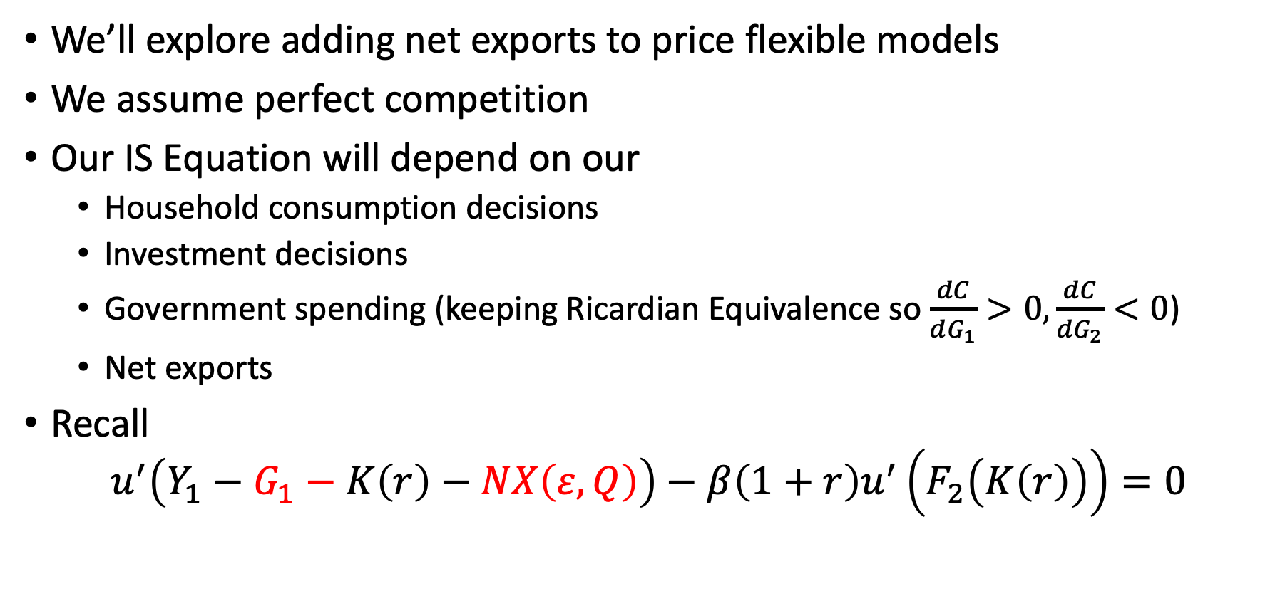
Adding Net Exports to Price Flexible Model
We’ll explore adding net exports to price flexible models
We assume perfect competition
Our IS Equation will depend on our
Household consumption decisions
Investment decisions
Government spending (keeping Ricardian Equivalence so $\frac{dC}{dG_{1}}>0,\frac{dC}{dG_{2}}<0$)
Net exports
Recall
$$u^{′}\left(Y_{1}−G_{1}−K\left(r\right)−NX\left(ε,Q\right)\right)−β\left(1+r\right)u^{′}\left(F_{2}\left(K\left(r\right)\right)\right)=0$$

Slide 27
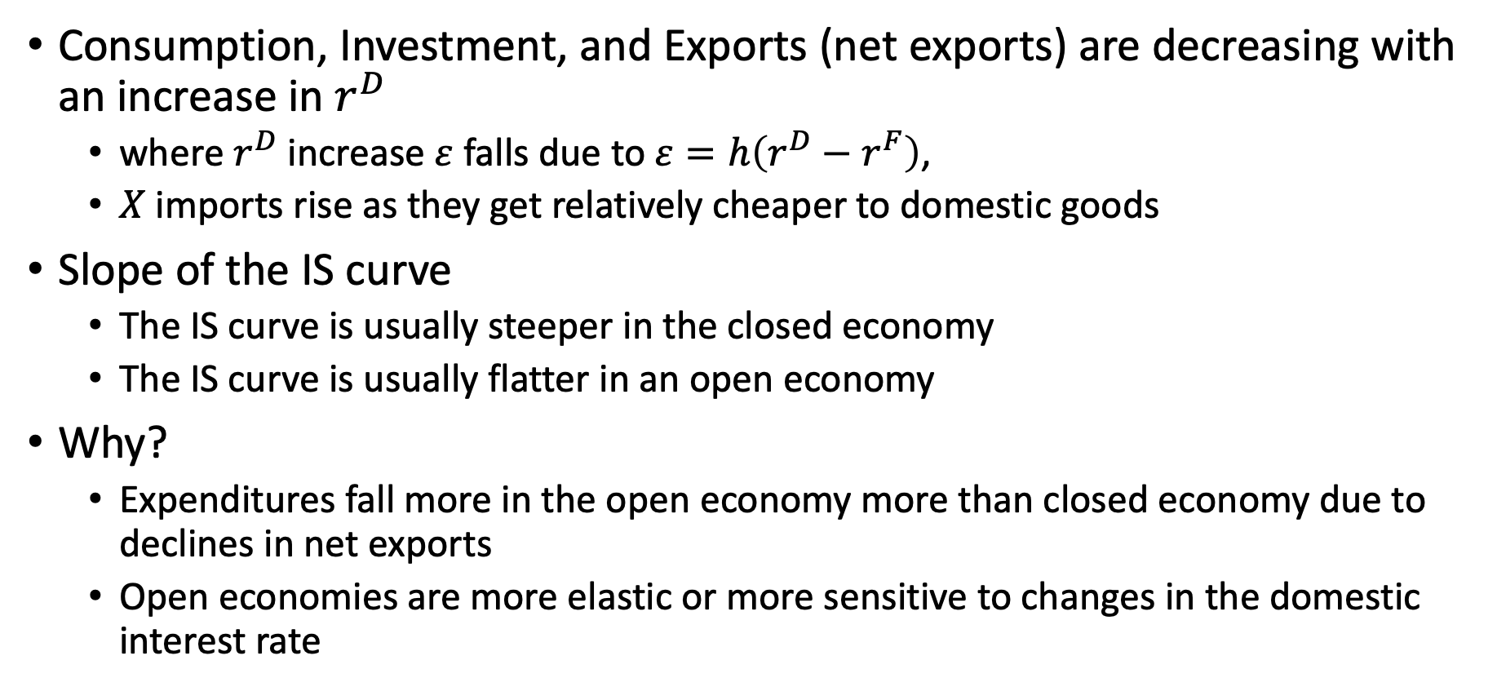
Adding Net Exports to Price Flexible Model
Consumption, Investment, and Exports (net exports) are decreasing with an increase in $r^{D}$
where $r^{D}$ increase $ε$ falls due to $ε=h\left(r^{D}−r^{F}\right)$,
$X$ imports rise as they get relatively cheaper to domestic goods
Slope of the IS curve
The IS curve is usually steeper in the closed economy
The IS curve is usually flatter in an open economy
Why?
Expenditures fall more in the open economy more than closed economy due to declines in net exports
Open economies are more elastic or more sensitive to changes in the domestic interest rate

Slide 28
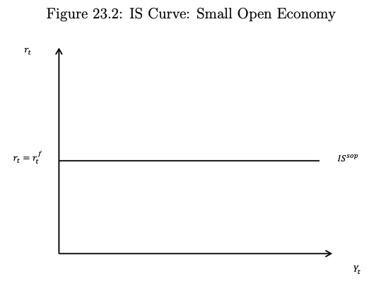
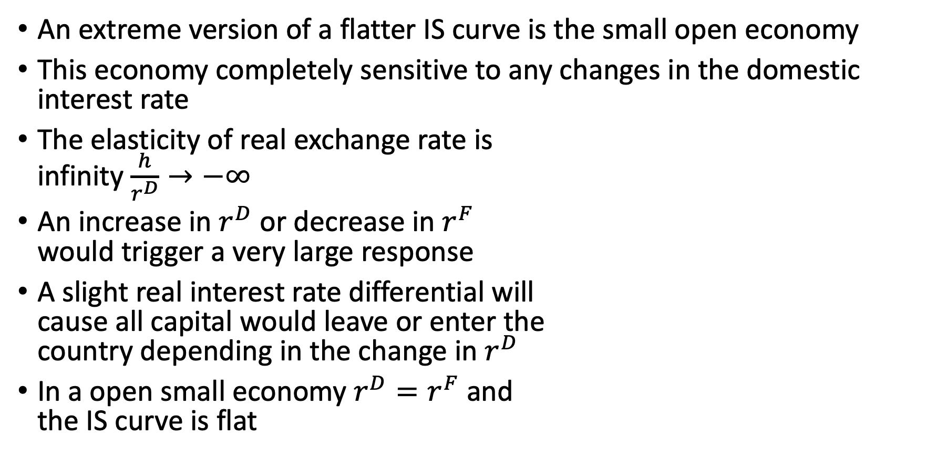
Open Small Economy
An extreme version of a flatter IS curve is the small open economy
This economy completely sensitive to any changes in the domestic interest rate
The elasticity of real exchange rate is infinity $\frac{h}{r^{D}}→−∞$
An increase in $r^{D}$ or decrease in $r^{F}$ would trigger a very large response
A slight real interest rate differential will cause all capital would leave or enter the country depending in the change in $r^{D}$
In a open small economy $r^{D}=r^{F}$ and the IS curve is flat

Slide 29
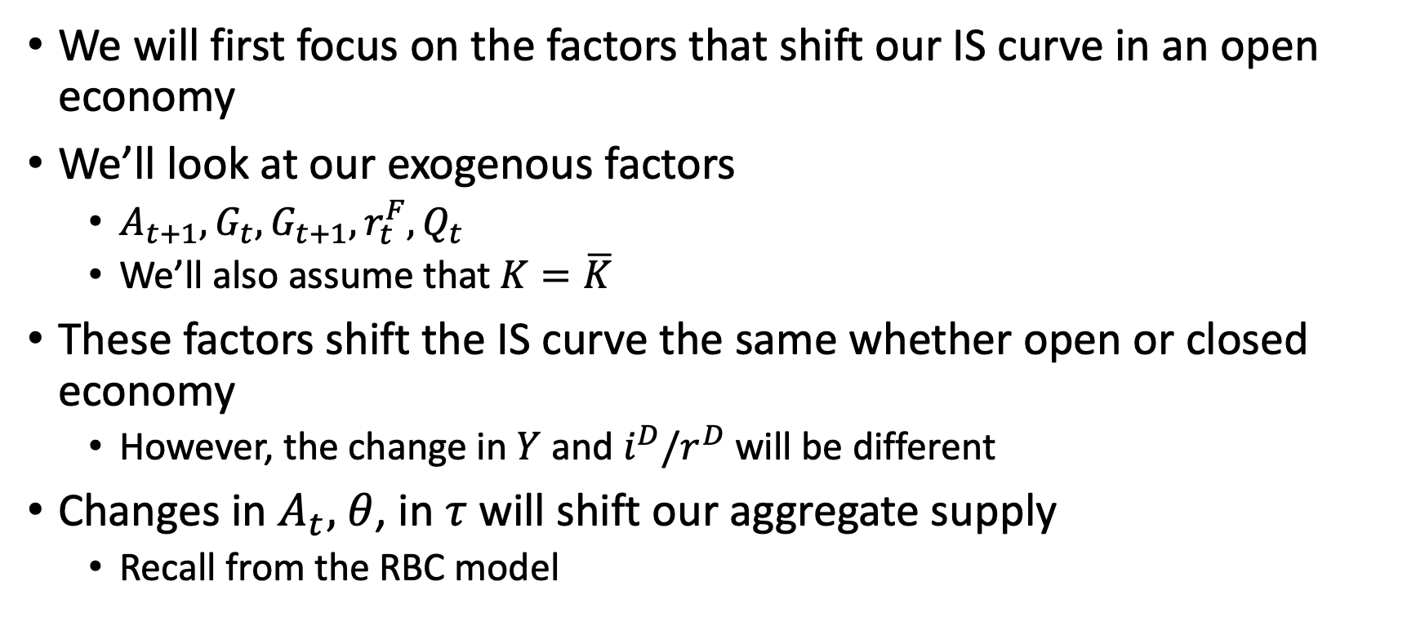
Shocks in Price Flexible Model
We will first focus on the factors that shift our IS curve in an open economy
We’ll look at our exogenous factors
$A_{t+1}, G_{t}, G_{t+1},r_{t}^{F},Q_{t}$
We’ll also assume that $K=\overline{K}$
These factors shift the IS curve the same whether open or closed economy
However, the change in $Y$ and $i^{D}/r^{D}$ will be different
Changes in $A_{t},$ $θ$, in $τ$ will shift our aggregate supply
Recall from the RBC model

Slide 30
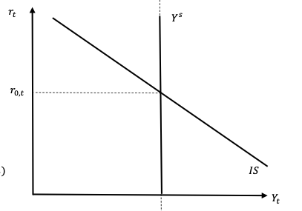
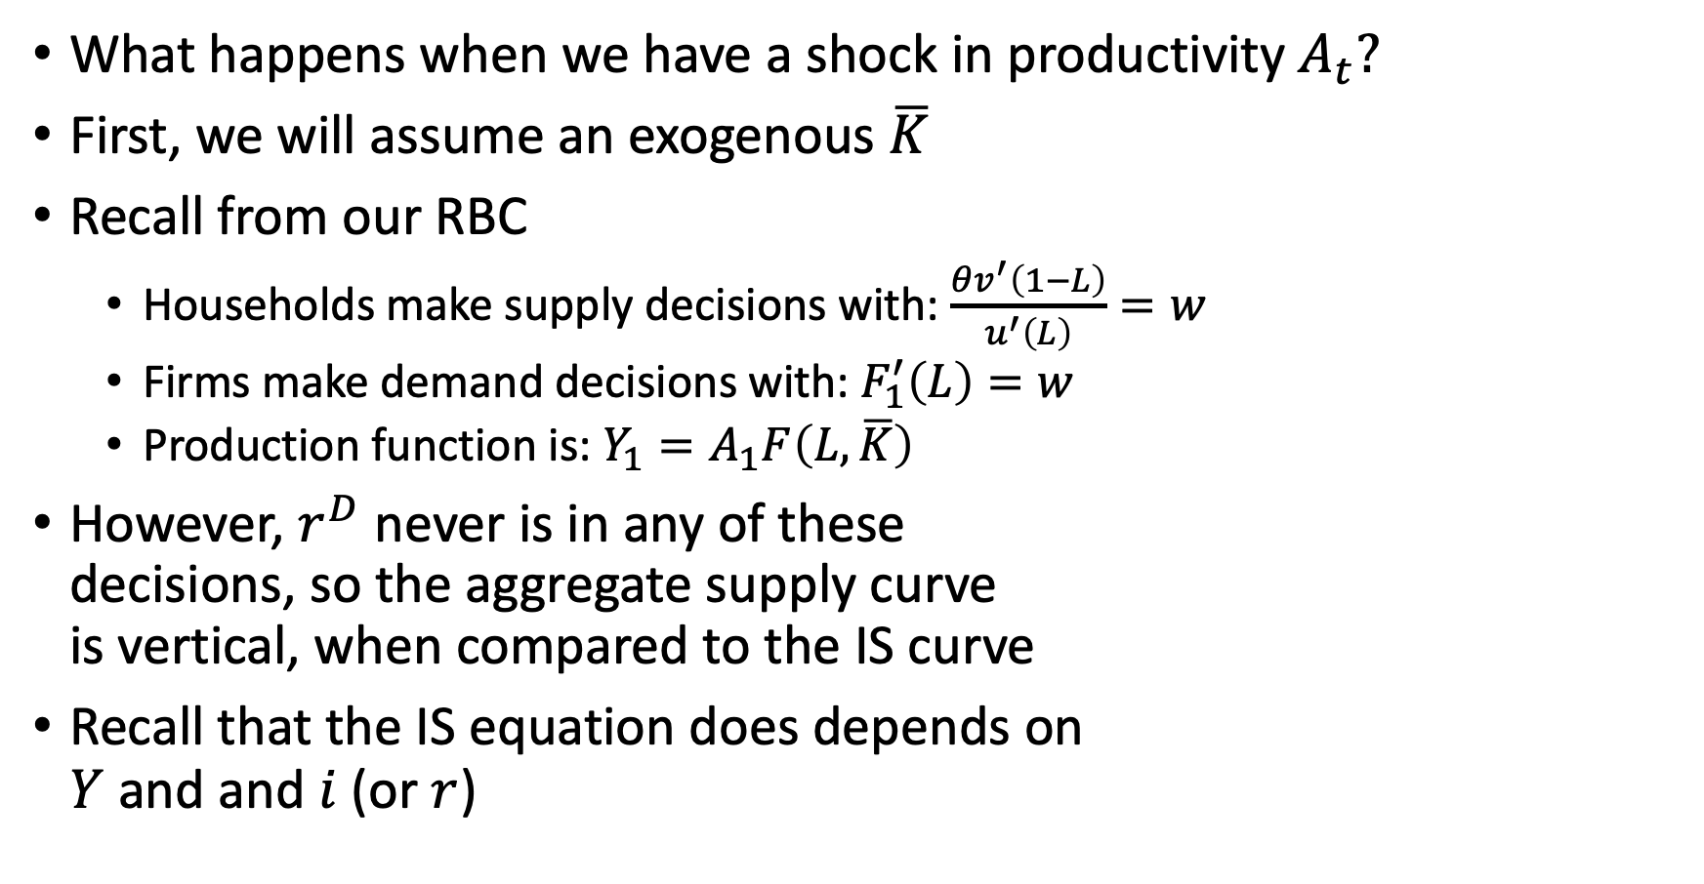
Shocks in Price Flexible Model
What happens when we have a shock in productivity $A_{t}?$
First, we will assume an exogenous $\overline{K}$
Recall from our RBC
Households make supply decisions with: $\frac{θv^{′}\left(1−L\right)}{u^{′}\left(L\right)}=w$
Firms make demand decisions with: $F_{1}^{′}\left(L\right)=w$
Production function is: $Y_{1}=A_{1}F\left(L,\overline{K}\right)$
However, $r^{D}$ never is in any of these decisions, so the aggregate supply curve is vertical, when compared to the IS curve
Recall that the IS equation does depends on $Y$ and and $i$ (or $r$)

Slide 31
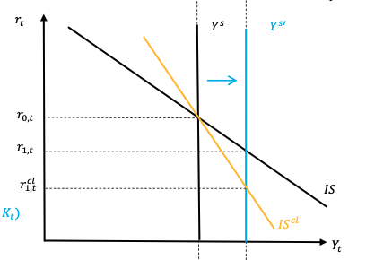
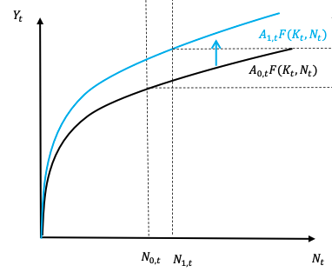
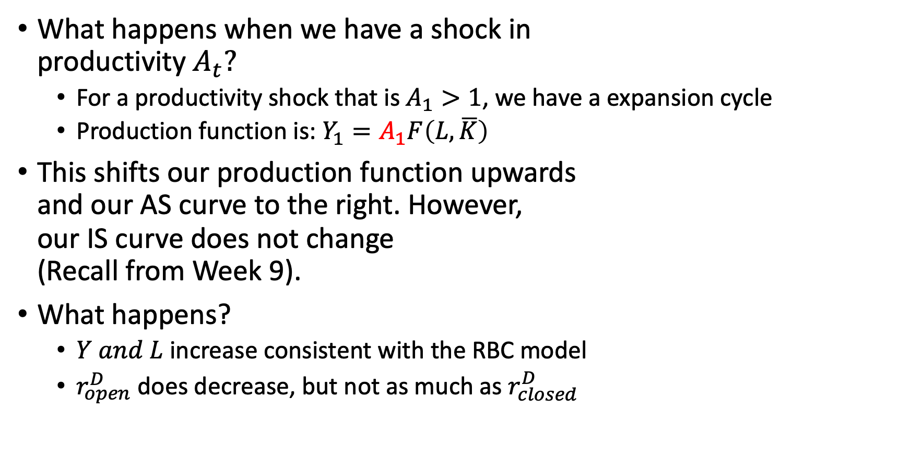
Shocks in Price Flexible Model
What happens when we have a shock in productivity $A_{t}?$
For a productivity shock that is $A_{1}>1$, we have a expansion cycle
Production function is: $Y_{1}=A_{1}F\left(L,\overline{K}\right)$
This shifts our production function upwards and our AS curve to the right. However, our IS curve does not change (Recall from Week 9).
What happens?
$Y and L$ increase consistent with the RBC model
$r_{open}^{D}$ does decrease, but not as much as $r_{closed}^{D}$

Slide 32
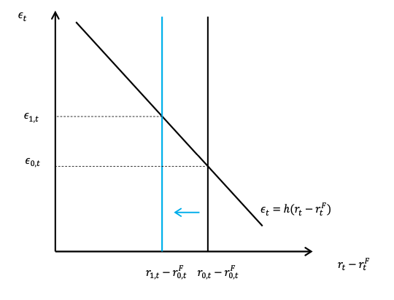
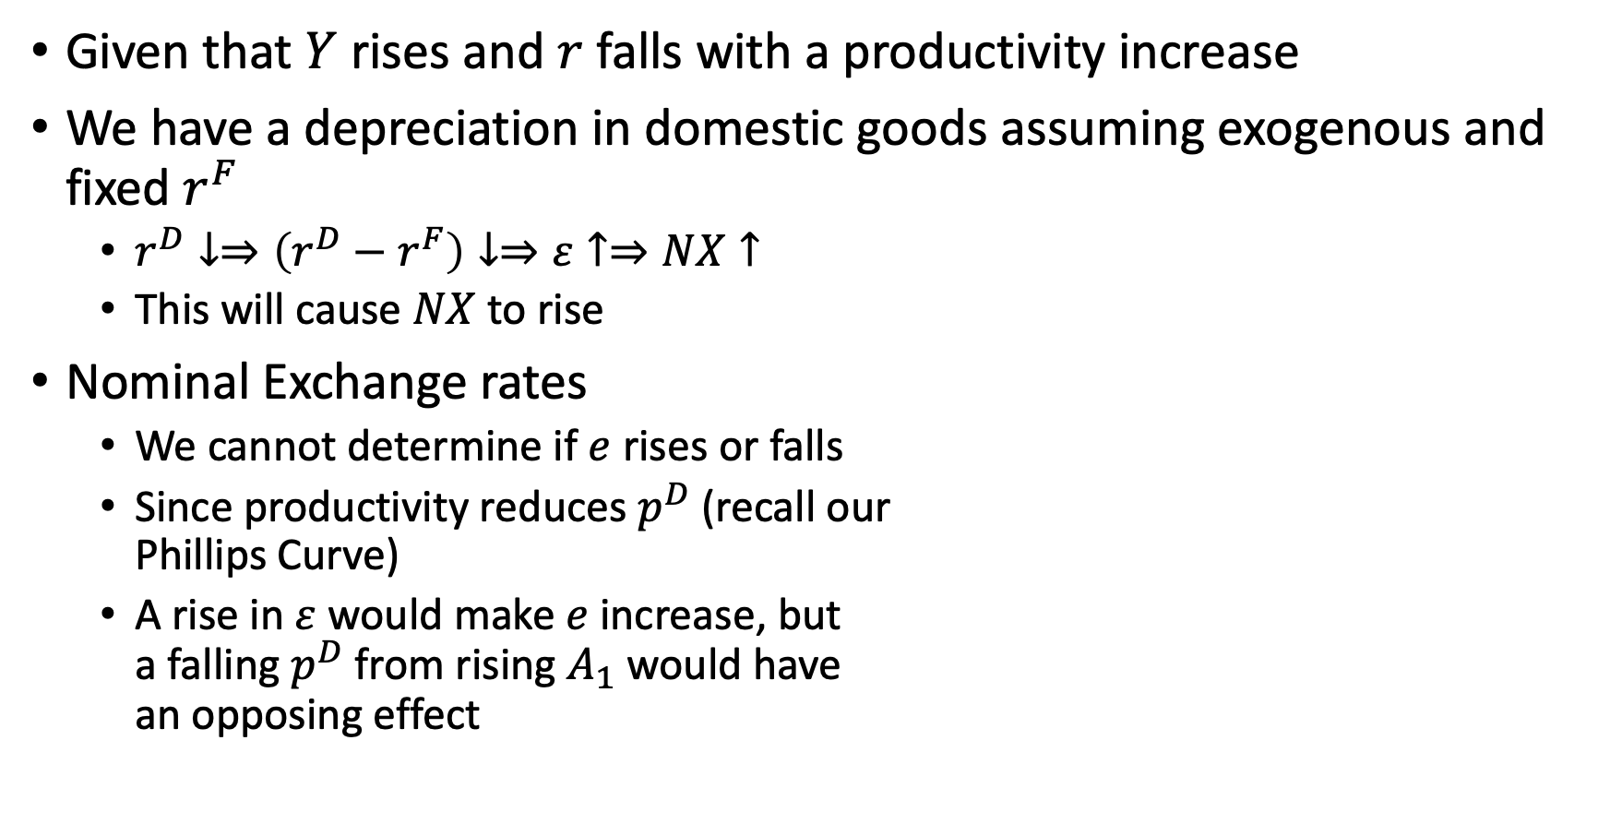
Shocks in Price Flexible Model
Given that $Y$ rises and $r$ falls with a productivity increase
We have a depreciation in domestic goods assuming exogenous and fixed $r^{F}$
$r^{D}↓⇒\left(r^{D}−r^{F}\right)↓⇒ε↑⇒NX↑$
This will cause $NX$ to rise
Nominal Exchange rates
We cannot determine if $e$ rises or falls
Since productivity reduces $p^{D}$ (recall our Phillips Curve)
A rise in $ε$ would make $e$ increase, but a falling $p^{D}$ from rising $A_{1}$ would have an opposing effect

Slide 33
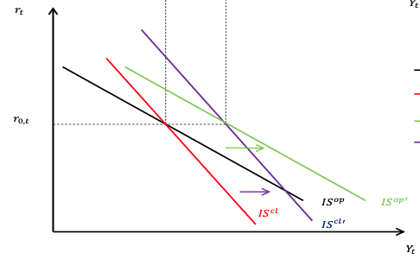
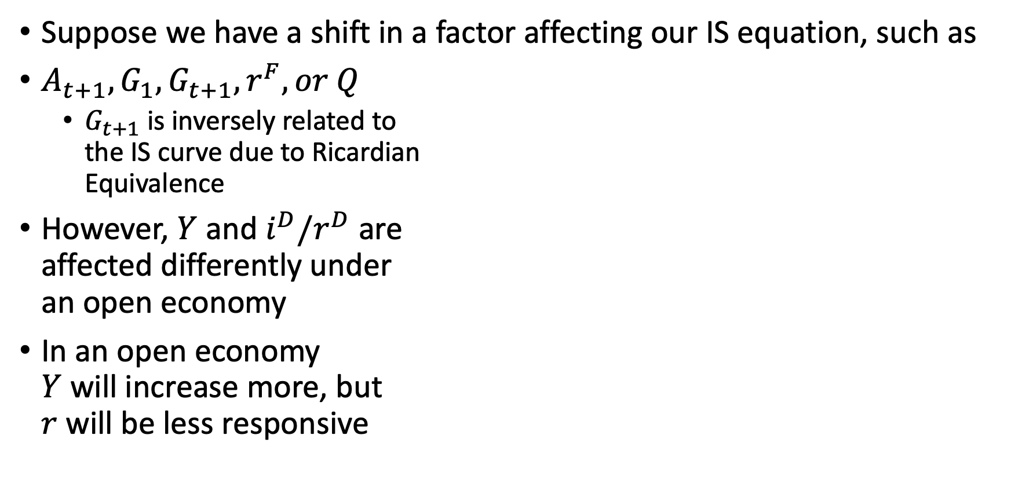
Shocks in Price Flexible Model
Suppose we have a shift in a factor affecting our IS equation, such as
$A_{t+1},G_{1},G_{t+1},r^{F}, or Q$
$G_{t+1}$ is inversely related to the IS curve due to Ricardian Equivalence
However, $Y$ and $i^{D}/r^{D}$ are affected differently under an open economy
In an open economy $Y$ will increase more, but $r$ will be less responsive

Slide 34
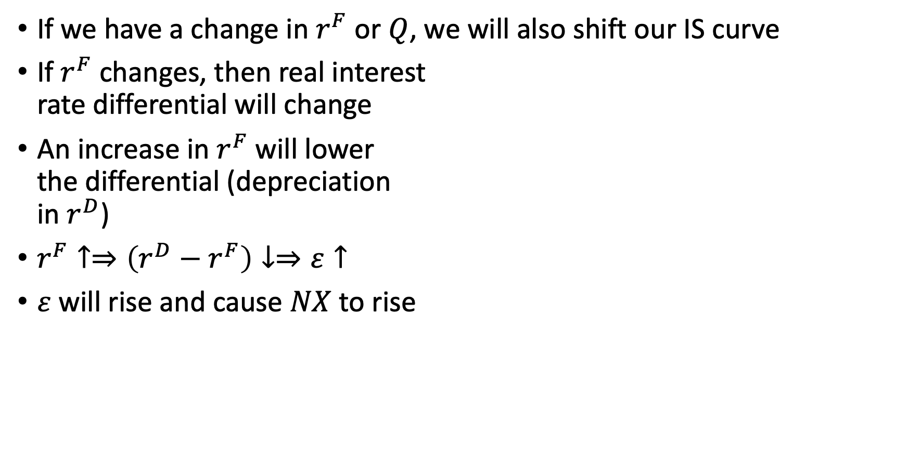
Shocks in Price Flexible Model
If we have a change in $r^{F}$ or $Q$, we will also shift our IS curve
If $r^{F}$ changes, then real interest rate differential will change
An increase in $r^{F}$ will lower the differential (depreciation in $r^{D}$)
$r^{F}↑⇒\left(r^{D}−r^{F}\right)↓⇒ε↑$
$ε$ will rise and cause $NX$ to rise

Slide 35
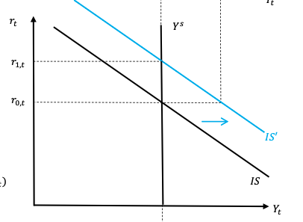
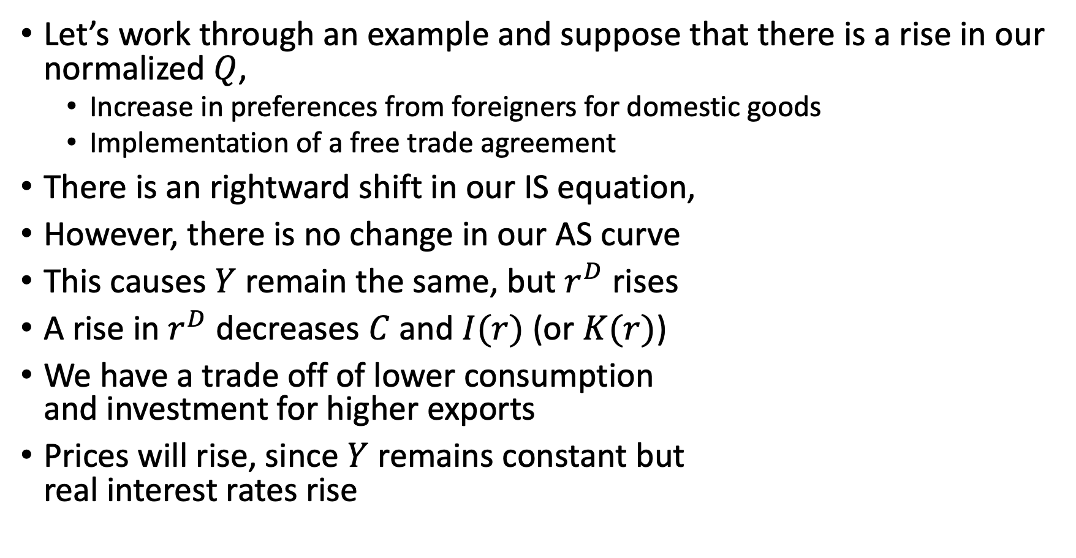
Shocks in Price Flexible Model
Let’s work through an example and suppose that there is a rise in our normalized $Q$,
Increase in preferences from foreigners for domestic goods
Implementation of a free trade agreement
There is an rightward shift in our IS equation,
However, there is no change in our AS curve
This causes $Y$ remain the same, but $r^{D}$ rises
A rise in $r^{D}$ decreases $C$ and $I(r)$ (or $K(r)$)
We have a trade off of lower consumption and investment for higher exports
Prices will rise, since $Y$ remains constant but real interest rates rise

Slide 36
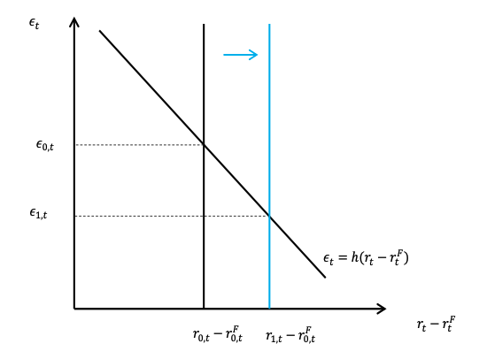
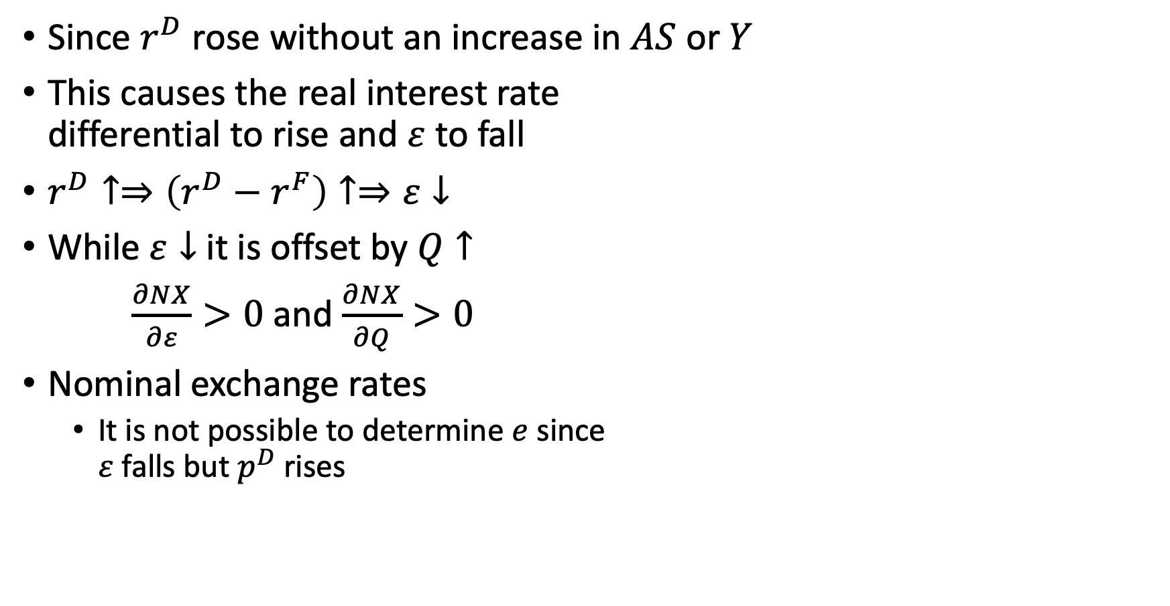
Shocks in Price Flexible Model
Since $r^{D}$ rose without an increase in $AS$ or $Y$
This causes the real interest rate differential to rise and $ε$ to fall
$r^{D}↑⇒\left(r^{D}−r^{F}\right)↑⇒ε↓$
While $ε↓$ it is offset by $Q↑$
$\frac{∂NX}{∂ε}>0$ and $\frac{∂NX}{∂Q}>0$
Nominal exchange rates
It is not possible to determine $e$ since $ε$ falls but $p^{D}$ rises

Slide 37
Adding Net Exports to Sticky Price Model

Slide 38
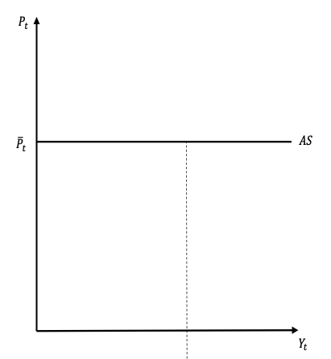
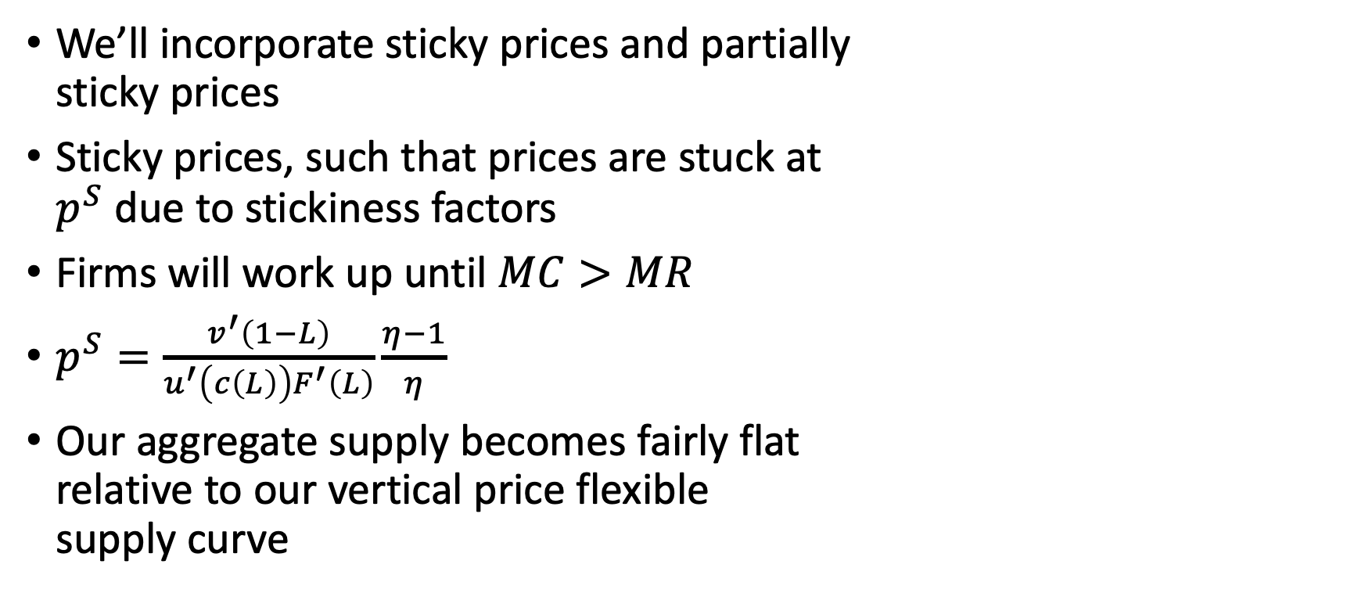
Adding Net Exports to Sticky Price Models
We’ll incorporate sticky prices and partially sticky prices
Sticky prices, such that prices are stuck at $p^{S}$ due to stickiness factors
Firms will work up until $MC>MR$
$p^{S}=\frac{v^{′}\left(1−L\right)}{u^{′}\left(c\left(L\right)\right)F^{′}\left(L\right)}\frac{η−1}{η}$
Our aggregate supply becomes fairly flat relative to our vertical price flexible supply curve

Slide 39
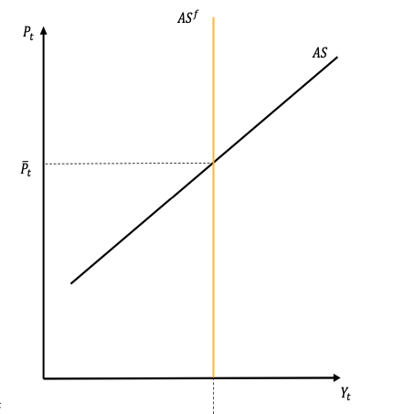
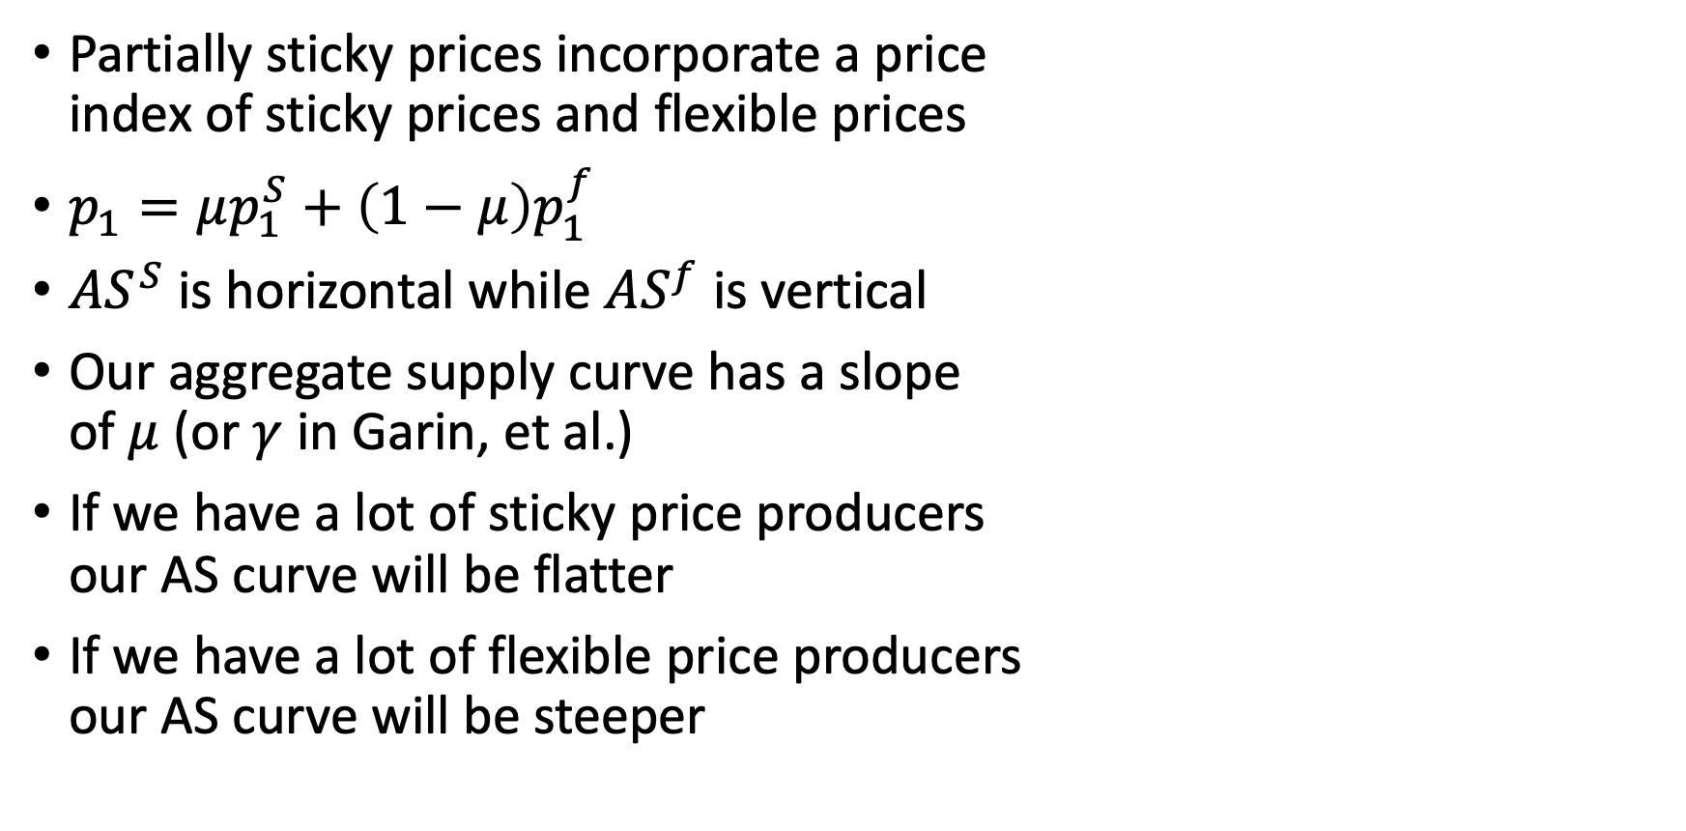
Adding Net Exports to Sticky Price Models
Partially sticky prices incorporate a price index of sticky prices and flexible prices
$p_{1}=μp_{1}^{S}+\left(1−μ\right)p_{1}^{f}$
$AS^{S}$ is horizontal while $AS^{f}$ is vertical
Our aggregate supply curve has a slope of $μ$ (or $γ$ in Garin, et al.)
If we have a lot of sticky price producers our AS curve will be flatter
If we have a lot of flexible price producers our AS curve will be steeper

Slide 40
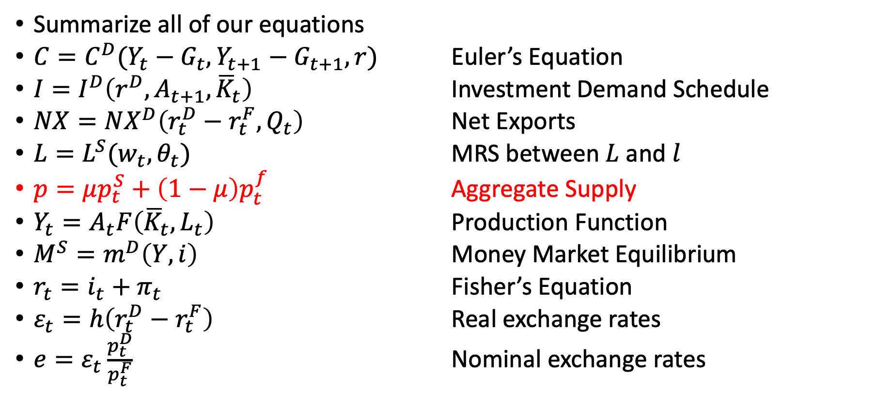
Adding Net Exports to Sticky Price Models
Summarize all of our equations
$C=C^{D}(Y_{t}−G_{t},Y_{t+1}−G_{t+1},r)$ Euler’s Equation
$I=I^{D}\left(r^{D},A_{t+1},{\overline{K}}_{t}\right)$ Investment Demand Schedule
$NX=NX^{D}\left(r_{t}^{D}−r_{t}^{F},Q_{t}\right)$ Net Exports
$L=L^{S}(w_{t},θ_{t})$ MRS between $L$ and $l$
$p=μp_{t}^{S}+\left(1−μ\right)p_{t}^{f}$ Aggregate Supply
$Y_{t}=A_{t}F\left({\overline{K}}_{t},L_{t}\right)$ Production Function
$M^{S}=m^{D}\left(Y,i\right)$ Money Market Equilibrium
$r_{t}=i_{t}+π_{t}$ Fisher’s Equation
$ε_{t}=h\left(r_{t}^{D}−r_{t}^{F}\right)$ Real exchange rates
$e=ε_{t}\frac{p_{t}^{D}}{p_{t}^{F}}$ Nominal exchange rates

Slide 41
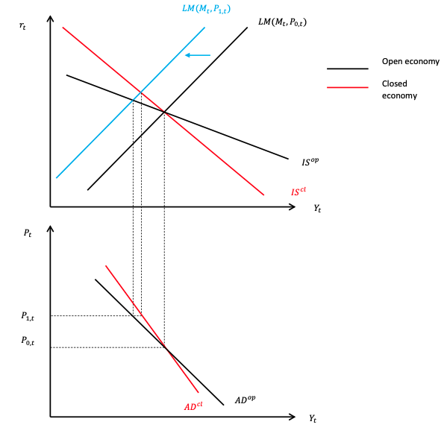
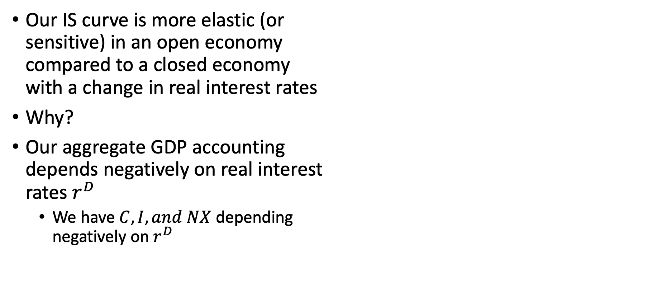
Aggregate Demand
Our IS curve is more elastic (or sensitive) in an open economy compared to a closed economy with a change in real interest rates
Why?
Our aggregate GDP accounting depends negatively on real interest rates $r^{D}$
We have $C,I, and NX$ depending negatively on $r^{D}$

Slide 42
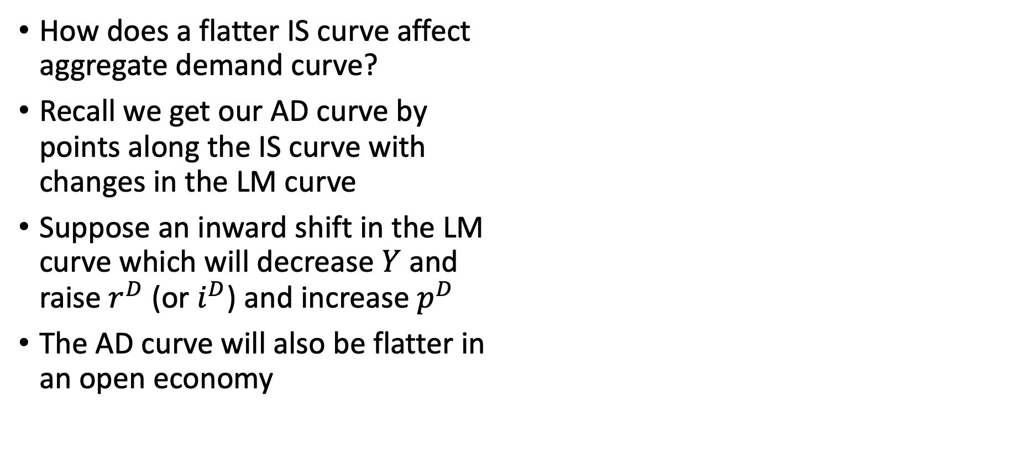
Aggregate Demand
How does a flatter IS curve affect aggregate demand curve?
Recall we get our AD curve by points along the IS curve with changes in the LM curve
Suppose an inward shift in the LM curve which will decrease $Y$ and raise $r^{D}$ (or $i^{D}$) and increase $p^{D}$
The AD curve will also be flatter in an open economy

Slide 43
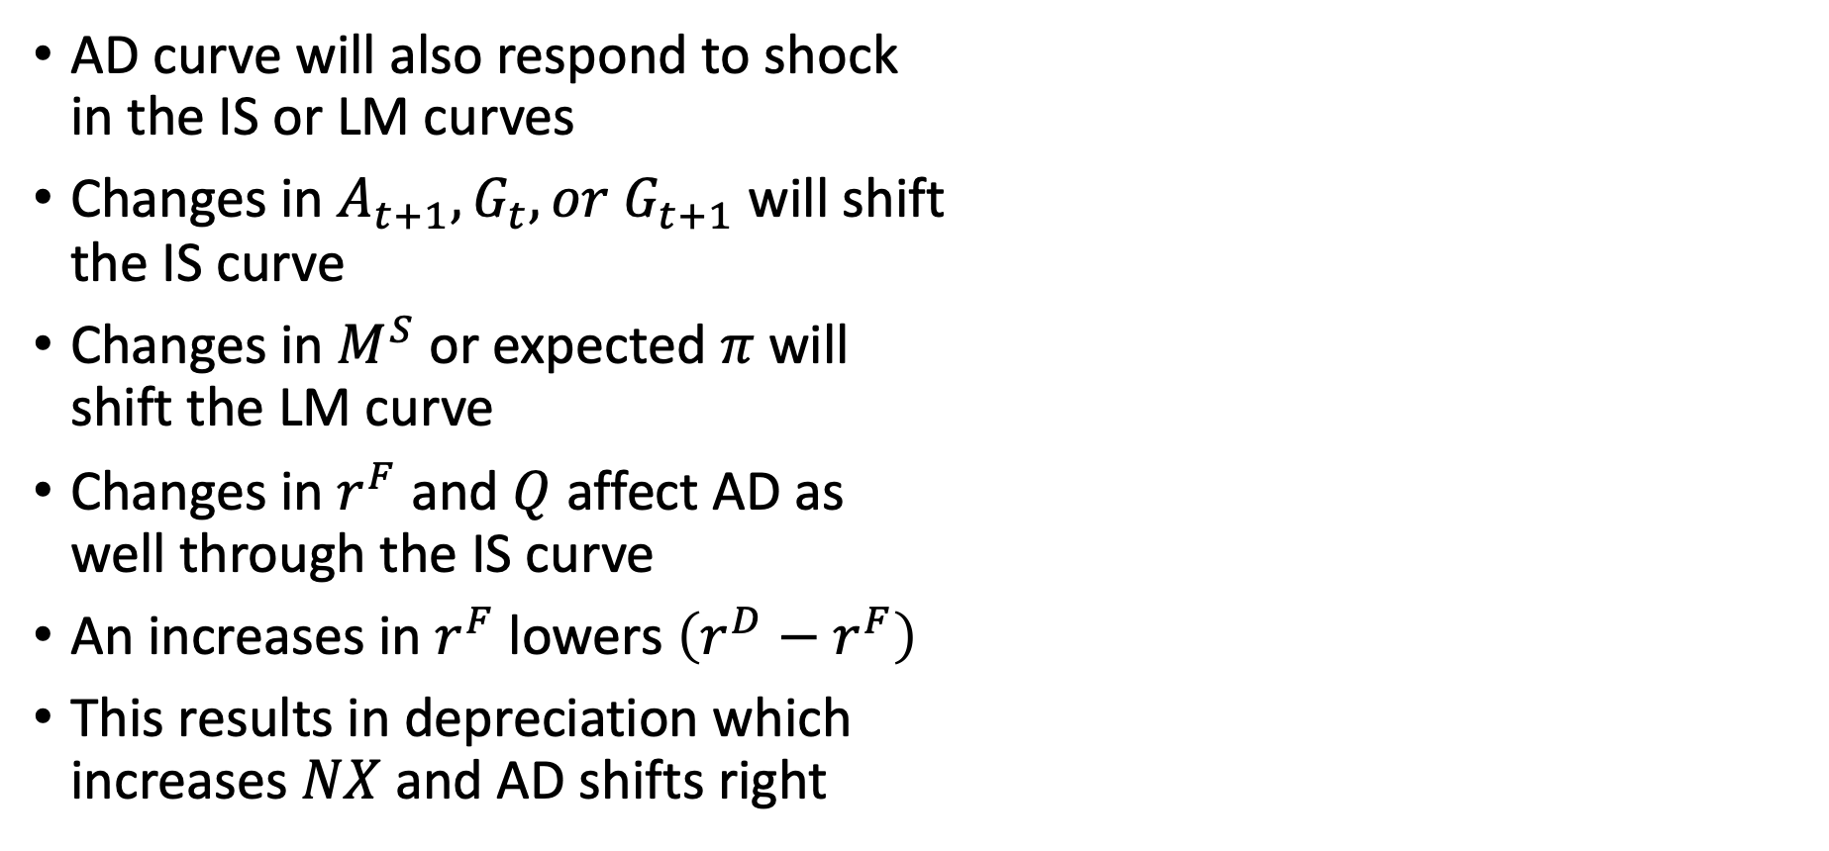
Aggregate Demand
AD curve will also respond to shock in the IS or LM curves
Changes in $A_{t+1},G_{t}, or G_{t+1}$ will shift the IS curve
Changes in $M^{S}$ or expected $π$ will shift the LM curve
Changes in $r^{F}$ and $Q$ affect AD as well through the IS curve
An increases in $r^{F}$ lowers $\left(r^{D}−r^{F}\right)$
This results in depreciation which increases $NX$ and AD shifts right

Slide 44
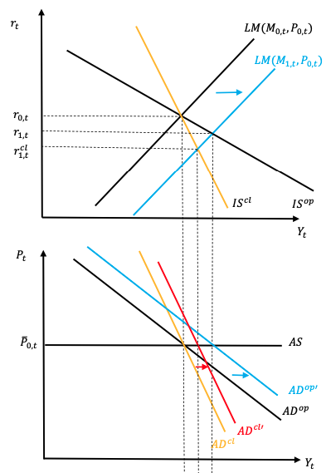
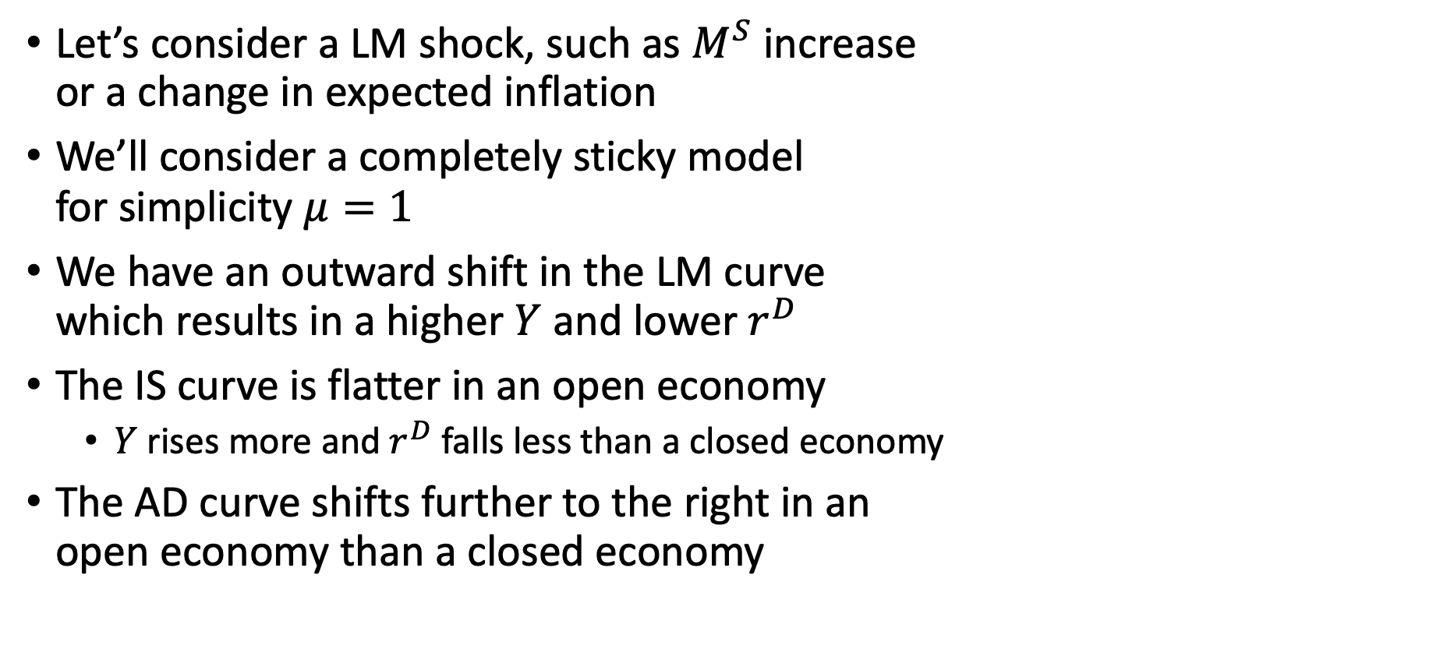
Open vs Closed with LM Shocks
Let’s consider a LM shock, such as $M^{S}$ increase or a change in expected inflation
We’ll consider a completely sticky model for simplicity $μ=1$
We have an outward shift in the LM curve which results in a higher $Y$ and lower $r^{D}$
The IS curve is flatter in an open economy
$Y$ rises more and $r^{D}$ falls less than a closed economy
The AD curve shifts further to the right in an open economy than a closed economy

Slide 45
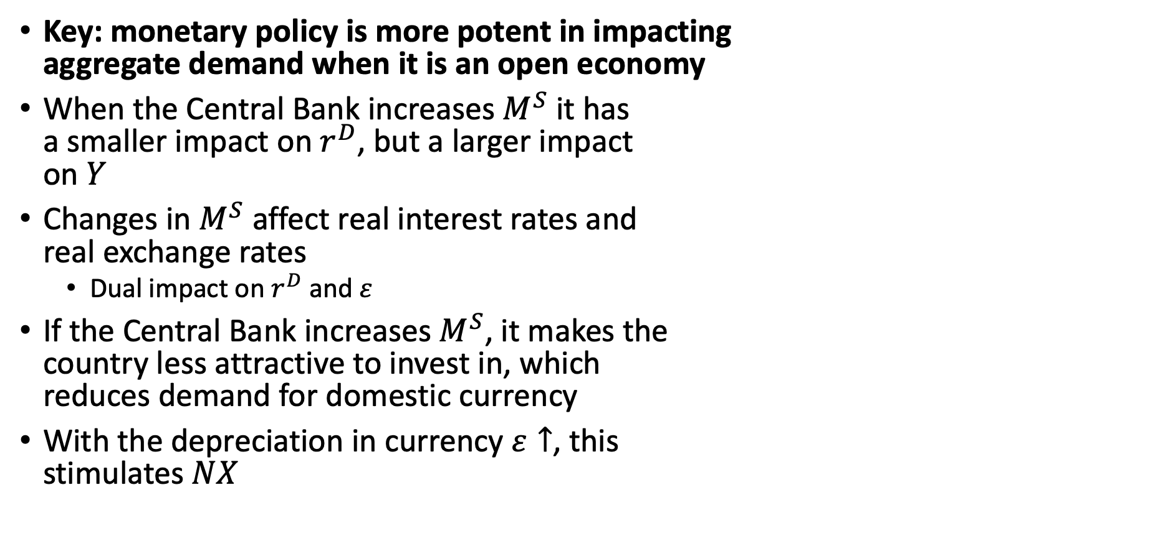
Open vs Closed with LM Shocks
Key: monetary policy is more potent in impacting aggregate demand when it is an open economy
When the Central Bank increases $M^{S}$ it has a smaller impact on $r^{D}$, but a larger impact on $Y$
Changes in $M^{S}$ affect real interest rates and real exchange rates
Dual impact on $r^{D}$ and $ε$
If the Central Bank increases $M^{S}$, it makes the country less attractive to invest in, which reduces demand for domestic currency
With the depreciation in currency $ε↑$, this stimulates $NX$

Slide 46


Open vs Closed with IS Shocks
Key: Shifts in due to IS Shocks result in smaller changes in an open economy compared to a closed economy
We could have a shock that shifts our IS curve to the right, such as $A_{t+1}↑, G_{t},↑ or G_{t+1}↓$
Both have similar shifts in the IS curve, but the impact on aggregate demand differs
The increase in $Y$ and $r^{D}$ are smaller due to the flatter slope of the open IS curve
The IS shocks raises $r^{D}$, which increases causes currency appreciation $\left(r^{D}−r^{F}\right)$, which decreases $ε$ and $NX$

Slide 47
Open vs Closed with IS Shocks
Key: Shifts in due to IS Shocks result in smaller changes in an open economy compared to a closed economy
We could have a shock that shifts our IS curve to the right, such as $A_{t+1}↑, G_{t},↑ or G_{t+1}↓$
Both have similar shifts in the IS curve, but the impact on aggregate demand differs
The increase in $Y$ and $r^{D}$ are smaller due to the flatter slope of the open IS curve
The IS shocks raises $r^{D}$, which increases causes currency appreciation $\left(r^{D}−r^{F}\right)$, which decreases $ε$ and $NX$

Slide 48

Overview of Shocks in an Open Economy
Key: the Central Bank has more potent responses in an open economy
Key: IS shocks, such as fiscal policy, have less potent shocks in an open economy

Slide 49


Small Open Economy
We’ll revisit our small open economy again
Recall that our IS curve is flat, where the elasticity of $r^{D}→−∞$
The small open economy must set its $r^{D}$ equal to $r^{F}$

Slide 50


Small Open Economy
Let’s suppose there is a monetary expansion in the small open economy that shift the LM curve to the right
Why doesn’t $r^{D}$ change?
There is small downward pressure on $r^{D}$
There is small upward pressure on $ε$
The Central Bank’s focus in on $ε$, not $r^{D}$
An increase in $M^{S}$ depreciates $\left(ε↑\right)$ and increases $NX$

Slide 51

Small Open Economy
Let’s suppose that there is an fiscal policy for a shock to the IS curve
Because the elasticity of $r^{D}$ is completely elastic, there is no impact on $Y$ or $r$
However, with an increase in $G_{t}$
Small upward pressure on $r^{D}$
Downward pressure on $ε$
An increase in $G_{t}$ will crowd out $C$ and $NX$
The downward pressure on $ε$ causes $NX↓$
The increase in $G_{t}$ crowds out $C_{t}$

Slide 52

Small Open Economy
In a small open economy the effects of IS and LM shocks are exacerbated
LM shocks have bigger effects in small open economies compared to open economies
IS shock has no impact on output

Slide 53
Shocks in a Sticky Price Model

Slide 54

Shocks in a Sticky Price Model
We will cover IS and LM shocks in a sticky price model
For simplicity we will have completely sticky prices (horizontal AS)
We have already covered shocks in the IS Curve
$A_{t+1}, G_{t}, and G_{t+1}$ (and remember $G_{t+1}$ is a negative shock due to Ricardian Equivalence)
We have already covered shocks in the LM Curve
We’ll cover exogenous shocks to $NX$
An exogenous shock to $r^{F}$
An exogenous shock to $Q$

Slide 55



Shocks in $r^{F}$
Suppose that that there is an exogenous shock in foreign interest rates
$r^{F}$ experiences an increase, which causes a reduction in $r^{D}−r^{F}$
This causes a depreciation in the home currency $\left(ε↑\right)$ and $NX$ rise
This increased demand shifts the IS curve to the right
However, with a shift to the right in the IS curve, $r^{D}$ increases

Slide 56

Shocks in $r^{F}$
How does the endogenous increase in $r^{D}$ compare to the exogenous increase in $r^{F}$?
Suppose a completely vertical LM curve,
The increase in $r^{F}$ would be accompanied by no increase in $Y$
The increase in $r^{F}$ would cause lower $c$ and $I$
If $Y$ doesn’t change and $c$ and $I$ are lower then $NX$ has to make up the difference
However, $NX$ cannot increase if $(r^{D}−r^{F})$ increases, so even with a vertical LM, $r^{D}$ cannot rise as much as $r^{F}$
Since LM curve are usually not completely vertical, $r^{D}$ will rise less than $r^{F}$ which causes depreciation ($ε↑)$ and $NX↑$

Slide 57



Shocks in $Q$
Suppose we have a shock in our normalized variable $Q$ (free trade agreement, etc.)
An increase in $Q$ increase the demand for net exports $NX$
This shifts the IS curve rightward
What happens to $NX$ and $ε$ with this shift?
$Y{and r}^{D}$ rises from the shift in IS
The rise in $r^{D}$ causes $r^{D}−r^{F}$ to increase (assuming a fixed $r^{F}$) and causes the domestic currency to appreciate $ε↓$

Slide 58

Shocks in $Q$
While the upward pressure on $r^{D}$ causes the currency to appreciate and puts downward pressure on $NX$
However, there is upward pressure on $NX$ from a rise in $Q$ (it counters $ε↓$)
What happens on net?
Again suppose a vertical LM curve, and a rise in $Q$ raises $r^{D}$ but not $Y$
$c$ and $I$ will fall from a rise in $r^{D}$, but not $Y$
The appreciation ($ε↓$) will not offset the rise in $NX$from a rise in $Q$

Slide 59
Fixed Exchange Rates

Slide 60
Fixed Exchange Rates
Until this point, we have assumed that exchange rates float (flexible)
However, Central Banks may adopt a non-discretionary policy to keep exchange rates fixed
Bretton Woods Agreement
The Bretton Woods Agreement after World War II was an agreement
Gold was the basis for the US dollar
Other currencies were pegged to the value of the US dollar
The system ended in 1971 when the US no longer exchanged gold for US currency (US supply of gold was no longer adequate to cover the number of dollars in circulation)
Central Banks under Bretton Woods were allowed to choose their exchange arrangement as they saw fit
The World Bank and the International Monetary Fund were created as well

Slide 61

Fixed Exchange Rates
Under a Fixed Exchange Rate System, the Central Bank targets an exogenous value of nominal and real exchange rates
$$ε^{∗}=h\left(r^{D}−r^{F}\right)$$
$ε^{∗}$ and $r^{F}$ are exogenous variables, so solve for $r^{D}$
$$r^{D}=h^{−1}\left(ε^{∗}\right)+r^{F}$$
Note: $r^{D}$ does not have to equal $r^{F}$
Note: $r^{D}$ does have to move one-to-one with $r^{F}$ given $ε^{∗}$
Under a fixed exchange rate system, the Central Bank cedes discretionary power to set interest rates
It cannot simultaneously target $r^{D}$ and $ε^{∗}$

Slide 62

Fixed Exchange Rates
If a Central Bank wants discretion to use monetary policy to control $r^{D}$, then $ε$ must float
If a Central Banks wants to target $ε^{∗}$, then it must give up discretion to target $r^{D}$
What happens when there is a shock under a Fixed Exchange Rate System?
We’ll see what happens in the IS curve when there is a:
An increase from $A_{t+1} or G_{t},$ or a decrease in $G_{t+1}$
An increase from $r^{F}$ or an increase in $G_{t+1}$ (Recall Ricardian Equivalence)

Slide 63


Fixed Exchange Rates
Suppose that $A_{t+1}$ increases and the IS Curve shifts to the right
The increase in IS curve/equation causes an increase in $Y$ and $r^{D}$
However, the Central Bank needs to respond to reduce $r^{D}$ back to $r_{T}^{D}$
Given the Central Bank’s response, aggregate demand increases even more
If real exchange rates floated, the shift causes appreciation $\left(ε↑\right)$ and $NX↓$, but under fixed rates, $ε=ε^{∗}$

Slide 64
Fixed Exchange Rates
Key: under fixed exchange rate systems fiscal policy or other positive IS shock have a larger impact on output than a floating exchange rate system
In a sense, a fixed exchange rate system is closer to a closed economy near the Zero Lower Bound
Fiscal Policy has more potential, while monetary policy is more ineffective

Slide 65



Fixed Exchange Rates
Suppose there is an exogenous increase in $r^{F}$
Domestic interest rates must satisfy: $r^{D}=h^{−1}\left(ε^{∗}\right)+r^{F}$
The Central Bank must respond to the increase in $r^{F}$ by reducing $M^{S}$, which shifts the LM curve to the left
This reduces $Y$ and increases $r^{D}$
But, there is no appreciation or depreciation in currency ($ε=ε^{∗})$ and $NX$ does not change, so there is no change in the IS curve

Slide 66

Fixed Exchange Rates
This inward shift in the LM curve without an outward shift in the IS curve causes a contraction in aggregate demand
This decline spills over into consumption, investments, and employment due to increases in $r^{D}$ to keep $ε=ε^{∗}$
A fixed exchange system exposes an economy to potentially large changes in $r^{D}$ and $Y$
Key: A central bank must keep in lock step with $r^{F}$ regardless if it harms aggregate demand

Slide 67

Fixed Exchange Rates
With the potential for large changes in $Y$ and $r^{D}$, what is a benefit of having a fixed exchange rate system?
Exchange rates can be very volatile if it is allowed to float
Volatility creates uncertainty and poses problems for import/export contracts
Floating exchange rates are subject to non-fundamental speculation
Large financial firm trade currency hoping to make a profit
If a country is small enough, it may be subject to large swing due to irrational speculation instead of economic fundamentals
Artificially weakening a currency may help achieve an export-led economic development for a developing country
China did a similar method during the 1990s and early 2000s

Slide 68
Fixed Exchange Rates
Currency Unions
These are when multiple sovereign governments agree to use a single common currency
This creates a de facto fixed exchange rate
Areas with a currency union have fixed exchange rates
The US has a currency union among its states (Texas and Maryland)
The Euro has a currency union among its states (France and Italy)
What’s the difference?
US states are more synchronized and have a centralized fiscal authority
The US can smooth out economic conditions with transfers and fiscal spending
The EU has an almost non-existent fiscal authority
Greece could have benefited from floating exchange rate after the Great Recession

Slide 69

Summarize
Net exports depend upon
Real Exchange rates $ε$ which depends on $h\left(r^{D}−r^{F}\right)$
Other trade factors $Q$
Aggregate demand and the IS curves are flatter compared in an open economy
Monetary Policy is more impactful impact, while fiscal policy is less impactful fiscal policy in an open economy compared to a closed one
In a fixed exchange rate regime, monetary policy is less effective, while fiscal policy is more effective

